Slide 1



Not Disabled, Just Differently-Abled:
How to Ensure That ALL of Your Students Are Thriving in Your Class!
Catherine Fichten, Giso Iravani-Manesh, Alice Havel
Adaptech Research Network
Vanier Ped Day, Montreal
October 12th, 2022
Digital copy of our presentation: shorturl.at/abeS4
Fichten, C., Iravani-Manesh, G., & Havel, A. (2022, October 12). Not disabled, just differently-abled: How to ensure that ALL of your students are thriving in class [Invited speakers]. Vanier Ped Day, Montreal, QC, Canada.

Slide 2

Who Are We?
The Adaptech Research Network:
  Team: teachers, service providers, students, researchers,
  Research on post-secondary students with & without disabilities
  Focus on technologies
  Based at Dawson College
shorturl.at/abeS4
Notes:
To the audience, ask “show of hands, how many among you are…” teachers, administrators, professionals, etc.

Slide 3

Our Goals For the Session
Help make your materials accessible
Provide instructions on how to do these things
Encourage you to exchange information
shorturl.at/abeS4
Notes:
Share things that can help make a course accessible
Provide instructions on how to do these things
Encourage you to exchange information

Slide 4
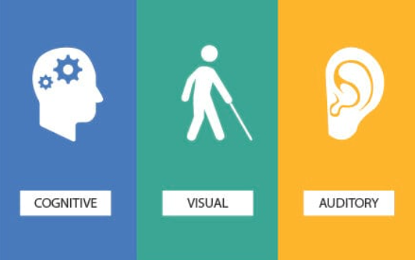
Ensure Accessibility
d/Deaf, hard of hearing
Poor color perception, no color perception
Blind, low vision
Specific learning disorders
Attention deficit hyperactivity disorder
Mental health related disabilities
… essentially, EVERYONE!
shorturl.at/abeS4

Slide 5

Sources of Information - Research
Research findings – ours & other researchers’
Questionnaires, focus groups, interviews
  Students
  Faculty
  Professionals
shorturl.at/abeS4

Slide 6

Sources of Information – Practice
Work with
  Students
  Faculty
  Professionals
COVID-19
  Good practices
shorturl.at/abeS4
Notes:
Remnants of practices that came about during COVID online meetings

Slide 7

Allow Use of Personal Tech In Class
Students like to use their personal tech in class
  Set clear guidelines
Students need personal tech to
  Get help
  Get organized
  Take class notes
  Read instructions or textbook
  Take photos of board or screen
shorturl.at/abeS4
Notes:
Remnants of practices that came about during COVID online meetings

Slide 8
Who Are the Students In Our Research?
15% to 20% of students self-reported a disability
50% had multiple disabilities
50% were not registered with accessibility services
Most frequent disabilities reported
  Mental health issues
  Attention deficit hyperactivity disorder (ADHD)
  Specific learning disorders
shorturl.at/abeS4

Slide 9


Make Sure Formats Are Accessible
Digital accessible
Format is important!
  For screen readers, text-to-speech, apps
Format includes
  Font, text size, spacing, colour, contrast
  Reading order
  Headings
  Alt text
shorturl.at/abeS4
Notes:
Digital does not necessarily mean that the document is accessible

Slide 10

Background
  Be mindful of your use of color & contrast
  Avoid distracting background images
shorturl.at/abeS4
Notes:
Avoid images with text if possible
A good text has no background image
Particularly for individuals with low color perception or no color perception

Slide 11

Use of Colors
  Avoid greens, reds/pinks, yellows, blues
shorturl.at/abeS4
Notes:
Particularly for individuals with color blindness

Slide 12
General Guidelines for PowerPoint Documents
Use sans serif font, such as Arial or Calibri
Use 40 point font for the titles
Use 36, 32, 30, 28 point font for the body
  Minimum 24 point font
Use high contrast between text & background
Avoid distracting background images
shorturl.at/abeS4

Slide 13
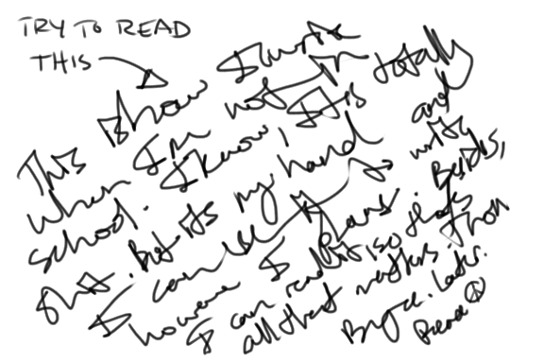
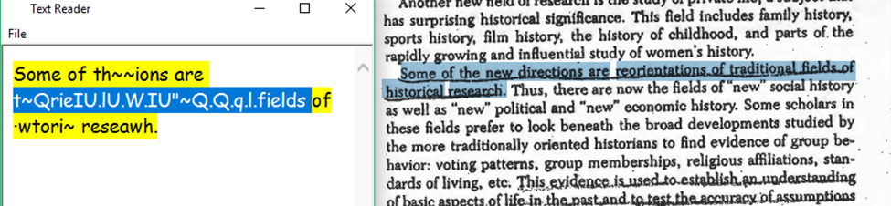
Course Packs: AVOID!
Italics & underlining (bold is best)
Missing or light text
Handwriting!
Content cut off at edges
Partial pages visible on side
https://www.uvic.ca/services/cal/courses/course-materials/coursespaces-material/index.php

Slide 14
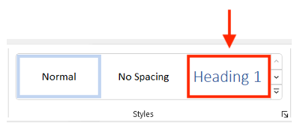

General Guidelines for Word Documents
Fonts: Sans Serif, Arial, Calibri
Font size: 12 - 14 points
Headings: 20% bigger
  Use Styles / Headings
Backgrounds: single color
shorturl.at/abeS4

Slide 15
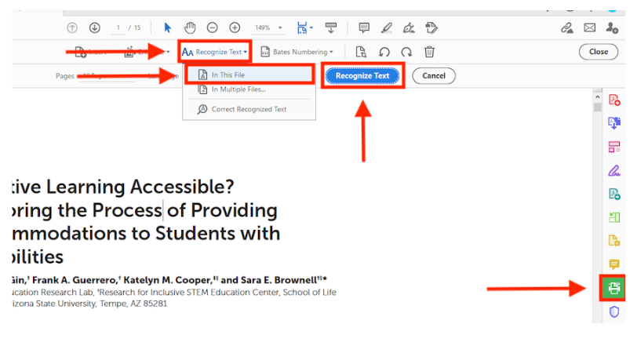
OCR Documents
Adobe Acrobat Pro DC: Scan & OCR → Recognize Text → In This File → Recognize Text
shorturl.at/abeS4
Notes:
Optical Character Recognition

Slide 16
Accessible Tables
Avoid tables – Excel is not always accessible!
  Add alt text to tables or graphs
  Label all cells in columns
  Number all rows
Row 1 | Name | Phone number | Email
Row 2 | Jane Doe | 555-123-4567 | Jane.Doe@gmail.com
Row 3 | John Smith | 555-456-7123 | John.Smith@outlook.com
shorturl.at/abeS4

Slide 17
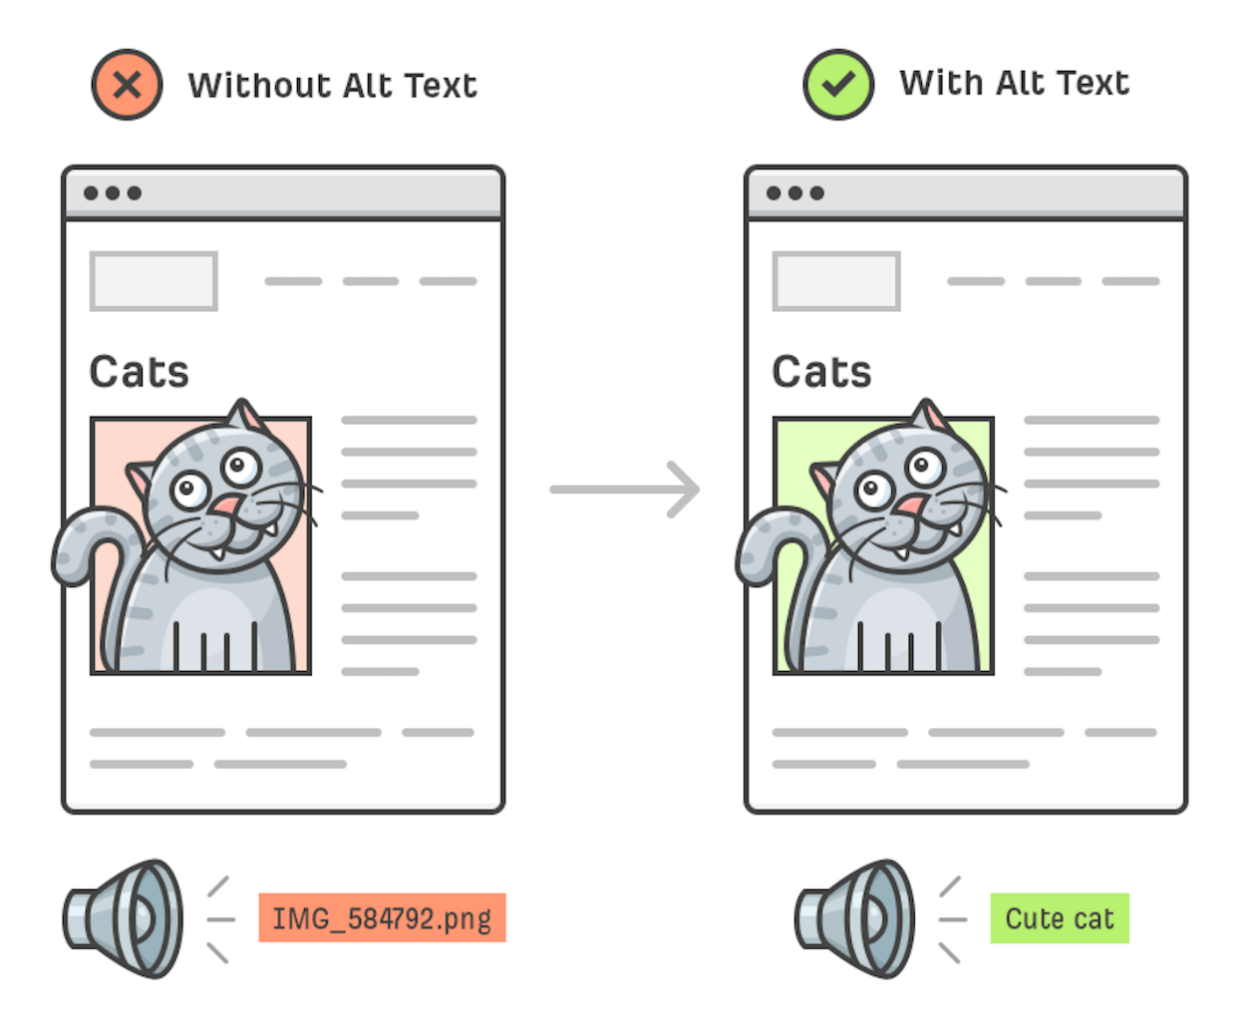
Alt Text
Add alt text to all images, graphs, and tables
  PDF
  Word
  Excel
  PowerPoint
  Google Docs
shorturl.at/abeS4

Slide 18
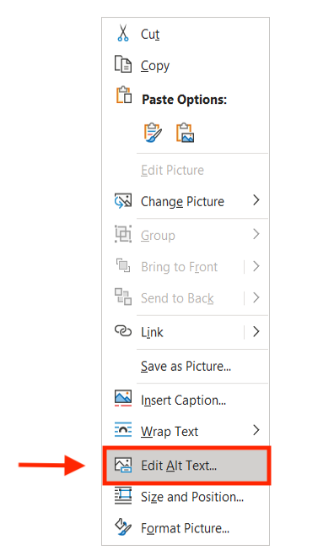
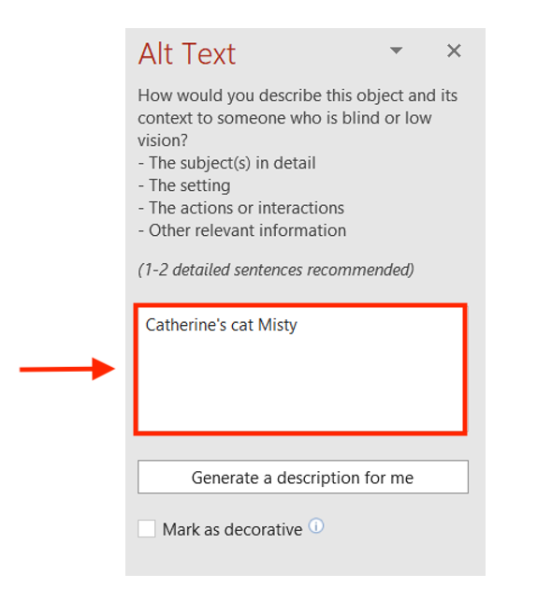
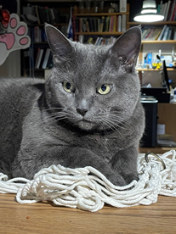
Alt Text – Word Documents
Windows: Right click on image → Edit Alt Text
shorturl.at/abeS4

Slide 19
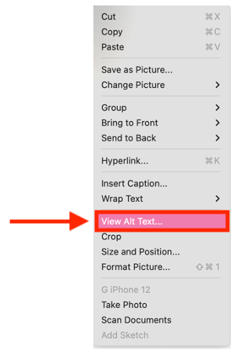
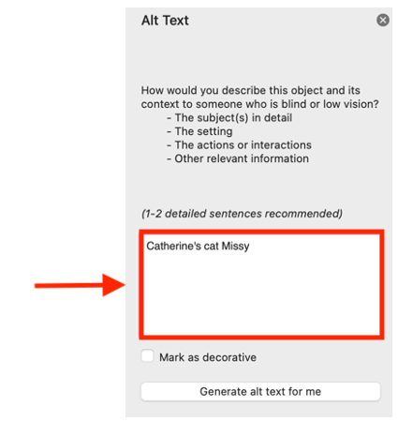
Alt Text – PowerPoints
Apple: Right-hand click on image → View Alt Text
shorturl.at/abeS4

Slide 20
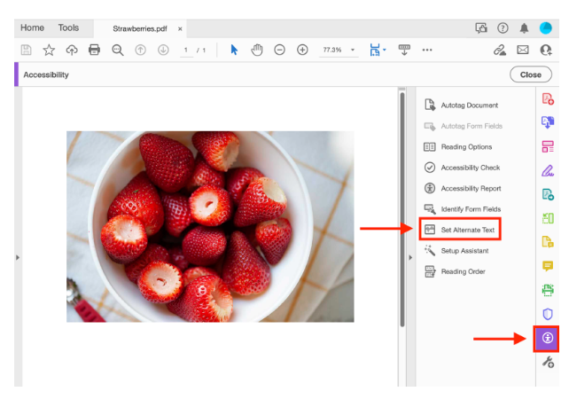
Alt Text - PDFs
(More) Tools → Accessibility → Set Alternate Text
shorturl.at/abeS4

Slide 21
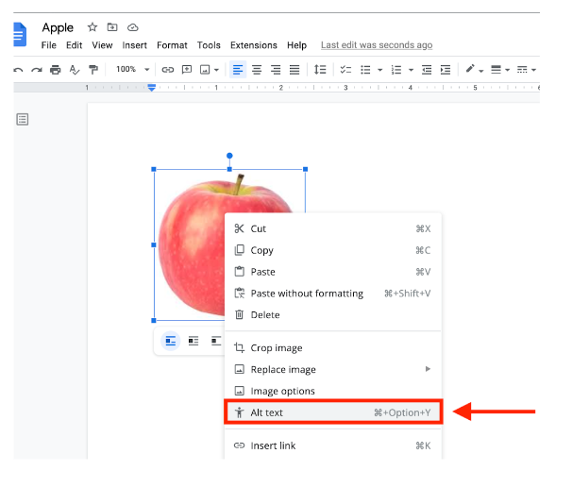
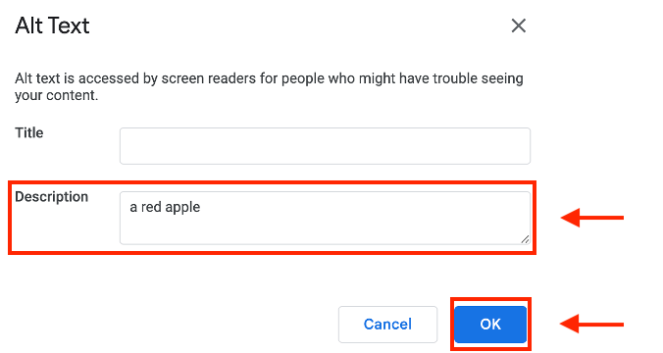
Alt Text – Google Docs
Right-hand click on image → Alt Text → add Description → Ok
shorturl.at/abeS4

Slide 22
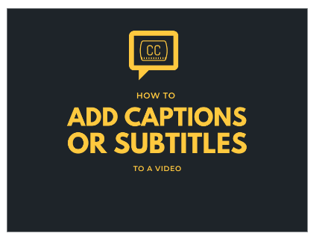
Captioning
Convert audio content into subtitles
  Automatic captions generated by AI
    Available on Zoom and TEAMS (must be activated by teacher
    Can be turned on and off by student
    May require editing (craptions)
      Unedited captions are better than nothing!
shorturl.at/abeS4
Notes:
For individuals with low or no hearing, alternatives to audio outputs are very important, such as subtitles
Always ensure your lips are visible (clear masks)

Slide 23
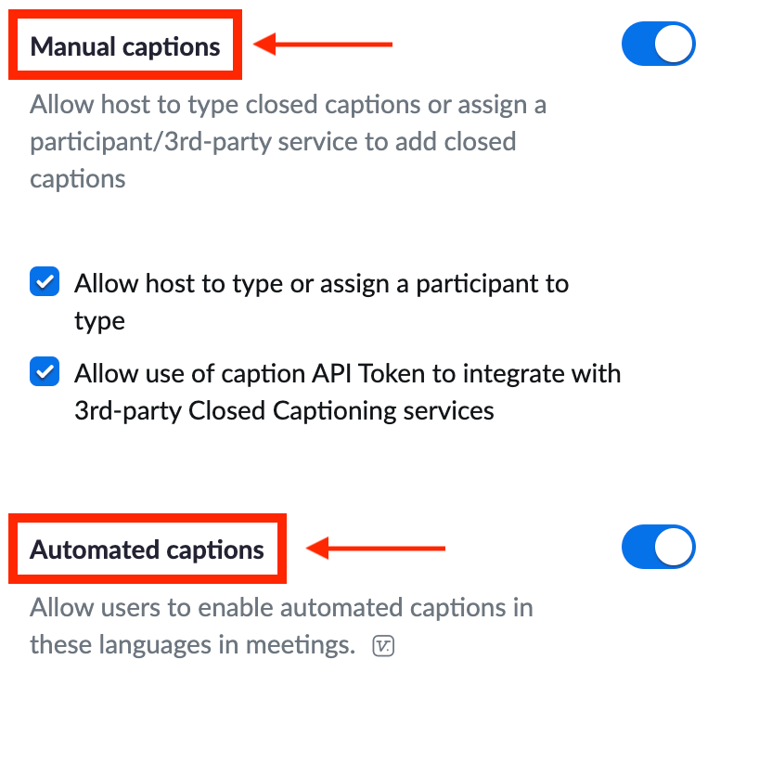
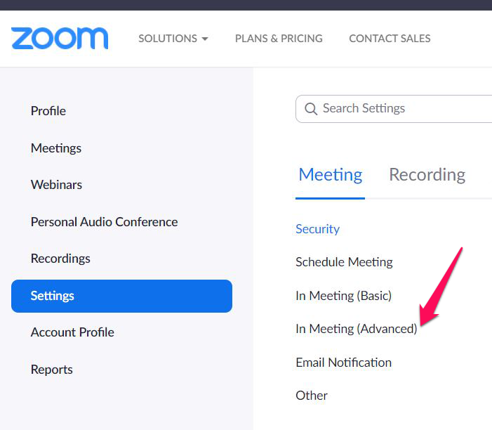
Zoom Captions
Log into your Zoom account (zoom.us) → Settings → In Meeting (Advanced) → Manual captions OR automated captions
shorturl.at/abeS4

Slide 24
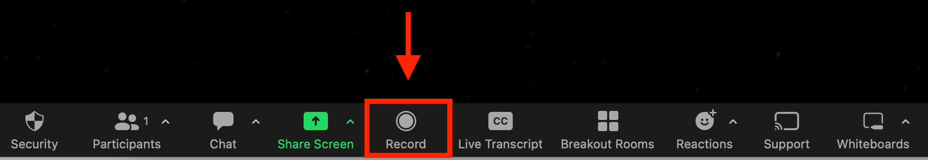
Recording Zoom Videos
Zoom → Record
shorturl.at/abeS4
Notes:
Say you have a class on Zoom, and want to record the video to share with your students to watch at later date

Slide 25
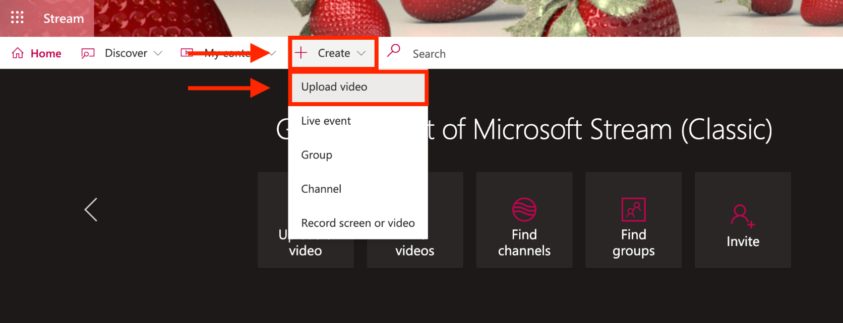

Adding Captions to Recorded Zoom Videos and Movies with Microsoft Stream
Stream → log in → Create → Upload Video
shorturl.at/abeS4

Slide 26
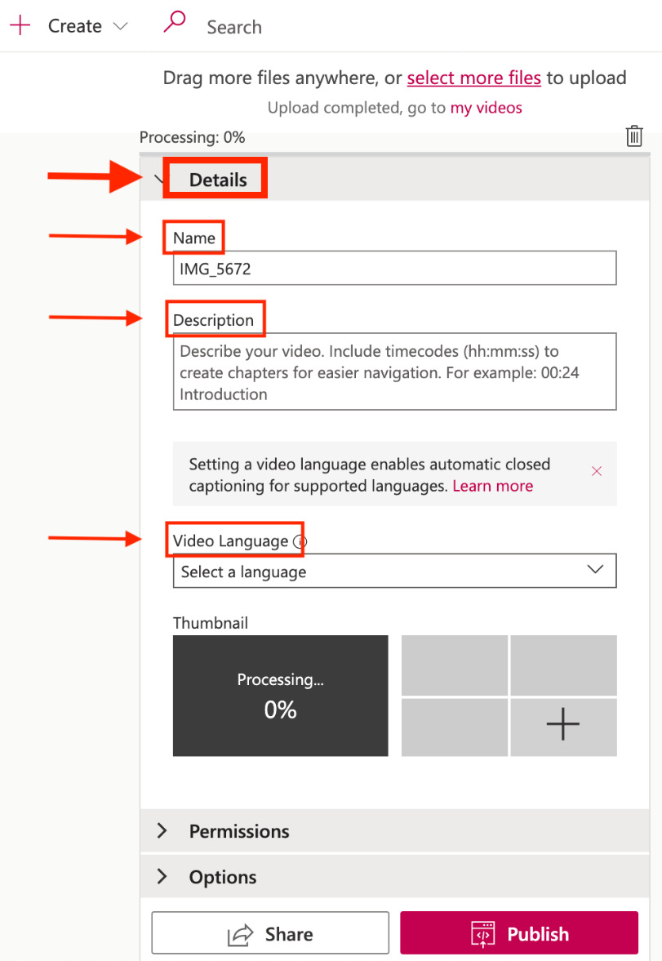
Adding Captions to Recorded Zoom Videos and Movies with Microsoft Stream (2)
In the Details section, fill in the necessary information
  File name
  Video language
  Description of the video
shorturl.at/abeS4

Slide 27
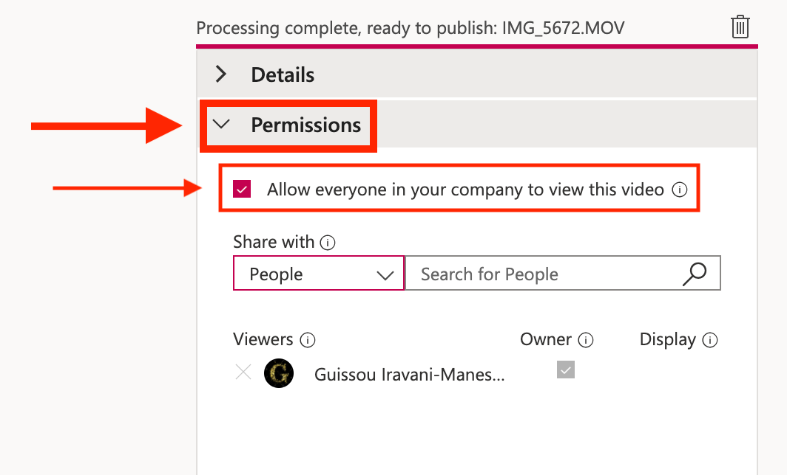
Adding Captions to Recorded Zoom Videos and Movies with Microsoft Stream (3)
In the Permissions section, make sure to click on “Allow everyone in your company to view this video”
shorturl.at/abeS4

Slide 28
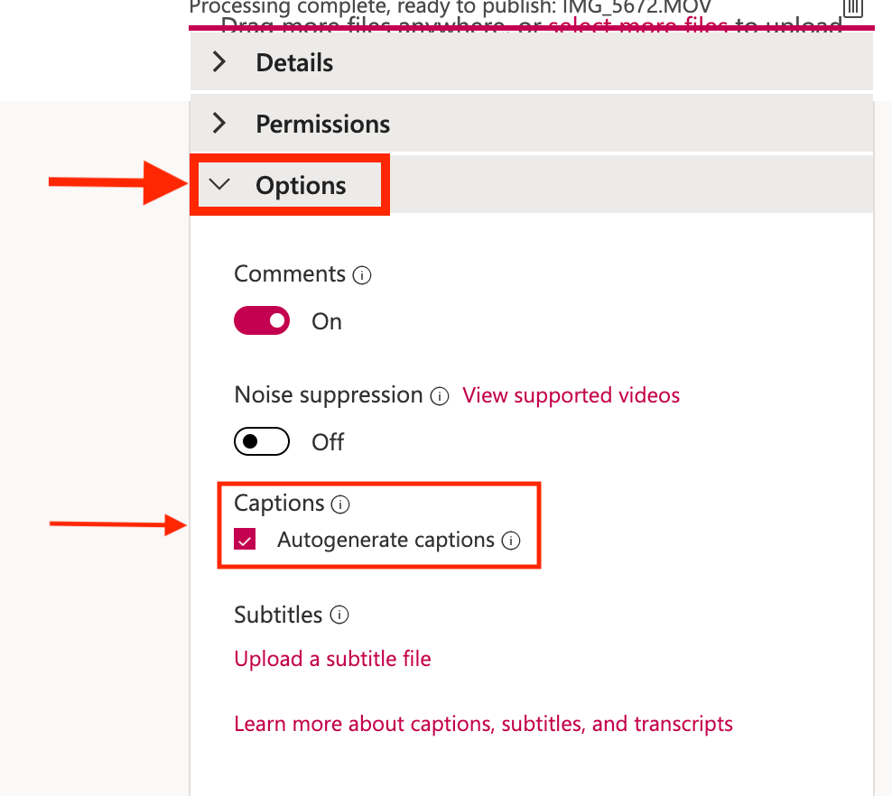
Adding Captions to Recorded Zoom Videos and Movies with Microsoft Stream (4)
In the Options section, make sure to click on “Autogenerate captions”
shorturl.at/abeS4

Slide 29
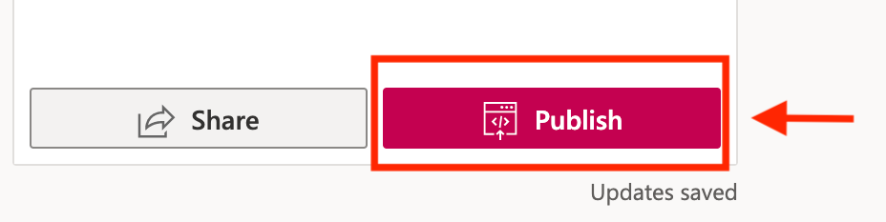
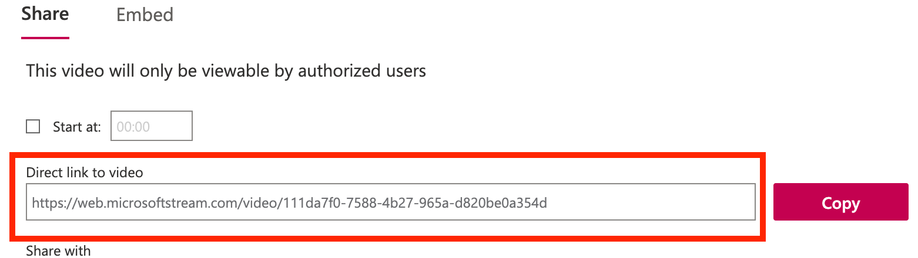
Adding Captions to Recorded Zoom Videos or Movies with Microsoft Stream (5)
Click on Publish or Share to complete the process
shorturl.at/abeS4

Slide 30
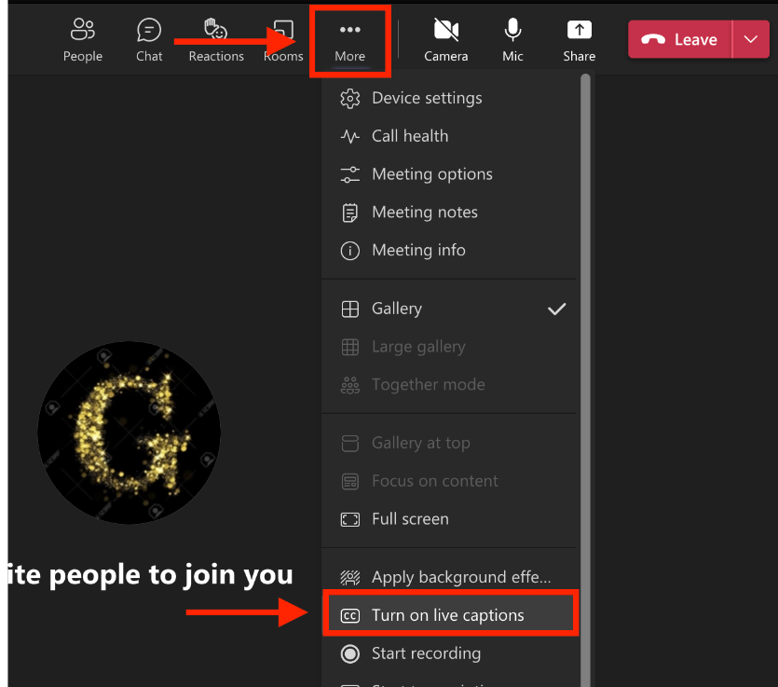
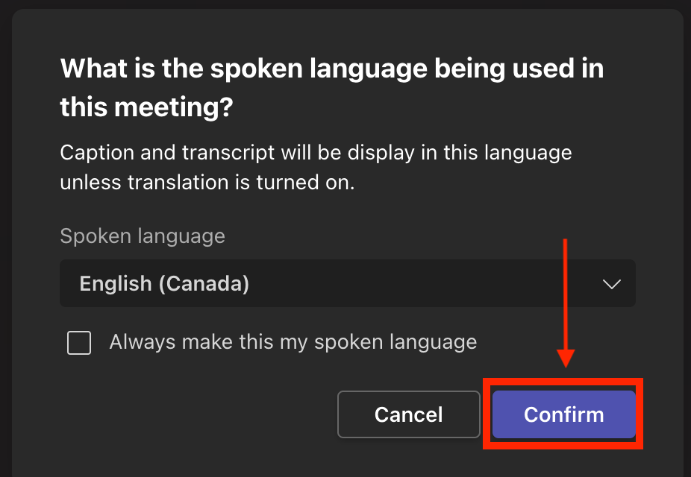
TEAMS Captions
Use captions on TEAMS
Start your TEAMS meeting → More → Turn on live captions → choose your language → Confirm
shorturl.at/abeS4

Slide 31
What Do You Think?
We want to hear you
(1) Opinions
(2) Experiences
(3) Questions
shorturl.at/abeS4

Slide 32

Resources
MOOC: Basics of Inclusive Design for Online Education https://www.coursera.org/learn/inclusive-design
E-Access Concordia Project https://adaptech.org/research/e-access-concordia-project/
Adaptech Research Network: www.adaptech.org
Catherine Fichten: cfichten@dawsoncollege.qc.ca
Alice Havel: ahavel@dawsoncollege.qc.ca
Giso Iravani-Manesh: giravanimanesh@dawsoncollege.qc.ca
shorturl.at/abeS4

