Slide 1




You Can DO-IT Too:
Making Your Teaching More Inclusive
Alice Havel, Catherine Fichten,
Mary Jorgensen, Laura King
Adaptech Research Network, Dawson College,
Cégep André-Laurendeau
6th Annual SALTISE Conference, June 5, 2017, Montréal, Québec

Slide 2

DO-IT (Disabilities, Opportunities, Internetworking, and Technology) Center
Promotes accessibility in classroom and workplace
Fosters application of universal design
Distributes online content, publications, and videos for free
http://www.washington.edu/doit/

Slide 3
Information Any Way You Want It
Publications
Free brochures, videos
Training manuals (e.g. Making STEM Instruction Accessible)
Online Communities of Practice (CoPs)

Slide 4

AccessCyberlearning
Tips for accessible online course
  http://www.washington.edu/doit/20-tips-teaching-accessible-online-course
Make sure that
  Screen readers can access content
  Can use with keyboard alone (no mouse)
  Videos captioned and audio described
  Content in a clear, consistent format

Slide 5
Universal Design
Design of learning environment without need for adaptation
Inclusive for all students
  Gender
  Age
  Ethnicity
  Disability
  Learning Style

Slide 6
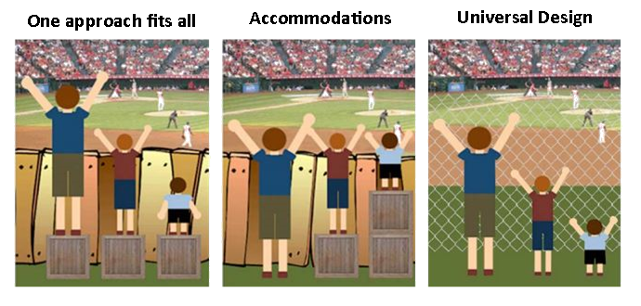
Universal Design

Slide 7
Universal Design
Applies to
  Educational products: websites, software, textbooks, lab equipment
  Environments: classrooms, libraries, distance learning courses
http://www.washington.edu/doit/universal-design-education-principles-and-applications

Slide 8
AccessSTEM
For students with disabilities in science, technology, engineering, and mathematics
Accessible science equipment
Accommodations for students with sensory impairments
http://www.washington.edu/doit/making-science-labs-accessible-students-disabilities

Slide 9
Creating Accessible Documents
  Make Word Accessible
      Use headings, lists, alternate text for images
      http://www.washington.edu/accessibility/documents/word/
If you scan
  Use PDF’s optical character recognition (OCR)
      http://www.washington.edu/doit/glossary-3
Notes:
Survey audience re their job/position. + Explain Cegep.

Slide 10
Web Accessibility
Principles of Accessible Design
  Provide alternative text
  Provide headers for data tables
  Make all forms accessible
  http://webaim.org/intro/#implementing

Slide 11

Captioning Videos
Open vs. closed captioning (CC)
YouTube
  Computer-generated captions
  MUST edit to make accurate
“How To” suggestions
  http://www.washington.edu/doit/creating-video-and-multimedia-products-are-accessible-people-sensory-impairments

Slide 12
Contact Us
  DO-IT
  http://www.washington.edu/doit/
  Alice Havel
  ahavel@dawsoncollege.qc.ca
  Catherine Fichten
  cfichten@dawsoncollege.qc.ca

