Slide 1



The Do’s and Don’ts of PowerPoints:
The Universal Design Perspective
Evelyne Marcil & Catherine Fichten
5th Annual SALTISE Conference, Montréal
June 3rd, 2016

Slide 2
According to you…
What makes a poor PowerPoint?
What makes a good PowerPoint?

Slide 3

TO GIVE US YOUR OPINION!

Slide 4
Example 1
Reporting (cont)
http://www.ntid.rit.edu/cat/summit/resources.html
Participant Evaluation Report (September 15, 2008, 12 pages)
  An analysis of the feedback and suggestions offered by Summit participants.
Bibliography on Remote Interpreting and Captioning (May 2008, 300 pages)
  References used to support discussion at the Summit.

Slide 5
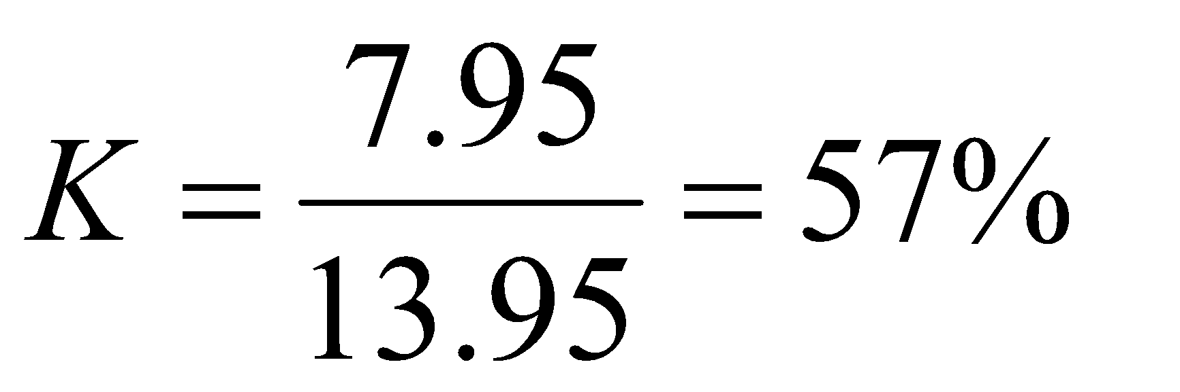
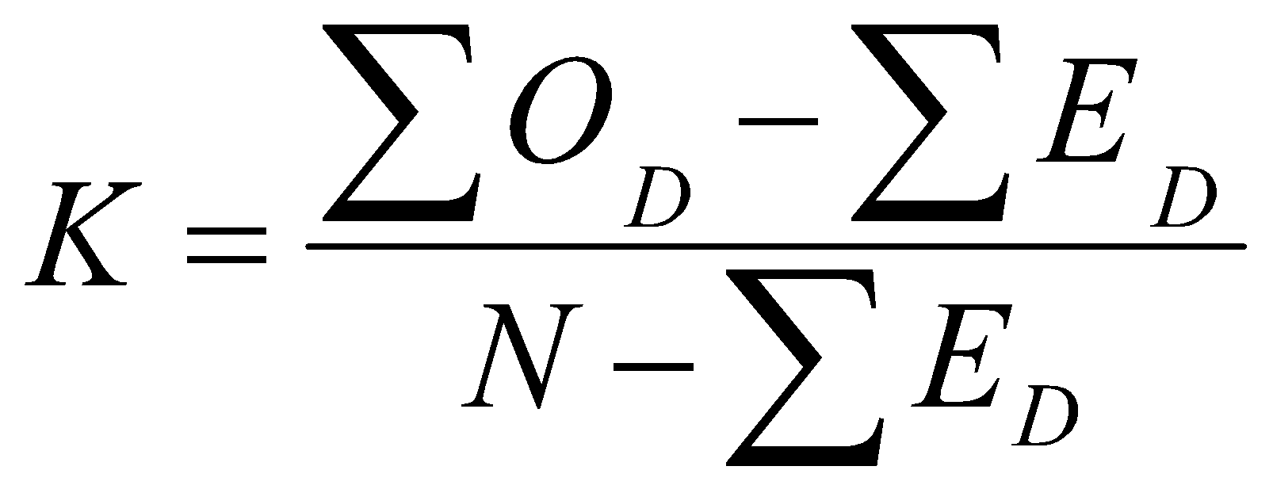
Example 2
Measure of agreement (from Cohen)
Though two folks (or groups of people) might agree, they might also have a predisposition to respond in a certain way anyway
Kappa takes this into consideration to determine how much agreement there would be after incorporating what we would expect by chance
  O and E refer to the observed and expected frequencies on the diagonal of the table of Judge 1 vs Judge 2
Judgements by clinical psychologists
on the severity of suicide attempts by clients.
At first glance one might think (10+5+3)/24 =
75% agreement between the two.
However this does not take into account
chance agreement.
 | Judge 1 |  |  | Totals
Judge 2 | 1 | 2 | 3
1 | 10 (5.5) | 2 | 0 | 12
2 | 1 | 5 (3.67) | 2 | 8
3 | 0 | 1 | 3 (.88) | 4
 | 11 | 8 | 5 | 24
Notes:
5

Slide 6
Example 3
Genetic factors
Genetic linkage and molecular biology studies have been used to pinpoint the possible genetic factors in SZ, conclusions:
      A case of “mistaken identity” – that is, some of these gene sites do not contribute to the disorder;
      Different kinds of SZ are linked to different genes; or
      SZ, like many disorders, is a polygenic disorder, caused by a combination of gene defects
Genetic factors may lead to the development of SZ through two kinds of (potentially inherited) biological abnormalities:
    Biochemical abnormalities
    Abnormal brain structure

Slide 7
Example 4
Internal Eating Cues:
  Stomach growling
External Eating Cues:
  Any external stimulus that tends to encourage hunger or to elicit eating.
  Tend to eat more when food is attractive and easily available.

Slide 8
Example 5

Slide 9
Universal Design
Planed from the beginning to be accessible to everyone, regardless of:
age
learning preference
cultural background
ability / disability
gender
etc.

Slide 10
The Do’s…
Pre-formatted slide layout
Title slides different from content slides
Arial or another sans serif font
Font size 36 (if possible, never smaller than 28)

Slide 11
The Do’s…
Maximize text / background contrast
Maximum of 7 lines per slide
Maximum 7 words per line
Images, tables and graphs “alt tagged” with legend

Slide 12
And the Don’ts
Shadowing, underlining, italics, funky fonts
Irrelevant movement
All capitals
Huge tables
Tight spacing between lines
Paragraphs

Slide 13
Remember
These are guidelines - not absolute rules
Adjust your design to your audience
Your personal touch / creativity is very important!

Slide 14
Questions?
Evelyne Marcil
emarcil@dawsoncollege.qc.ca
Catherine Fichten
cfichten@dawsoncollege.qc.ca

