Slide 1



Prepping for Inclusion: Easy Tips to Make Office 365 and Zoom More Accessible
Havel, A., & Fichten, C. (2022, June 2). Prepping for inclusion: Easy tips to make Office 365 and Zoom more accessible [Conference presentation]. 2022 SALTISE Conference, Montreal, QC, Canada.
Alice Havel & Catherine Fichten
Adaptech Research Network, Dawson College
Presentation at SALTISE
Montreal, June 2, 2022
Available at Rebrand.Ly/HavelFichten

Slide 2

Active Learning Accessibility Challenges ¹
Inaccessible LMS & homework platforms
Format of content not accessible (e.g., 3D diagrams)
No closed captioning
  Hard of hearing
  Second language learners
Incompatibility with adaptive technology
  E.g., screen reader, braille display
¹ https://www.lifescied.org/doi/epdf/10.1187/cbe.20-03-0049 Article: “Is Active Learning Accessible? Exploring the Process of Providing Accommodations to Students with Disabilities”

Slide 3

Online Accessibility
Designed to be usable by all
Can access using assistive technology
  Cannot assume digital = accessible
  Format important
    To access screen readers, text-to-speech, apps
    To change font, text size, spacing, colour
    To add notations

Slide 4
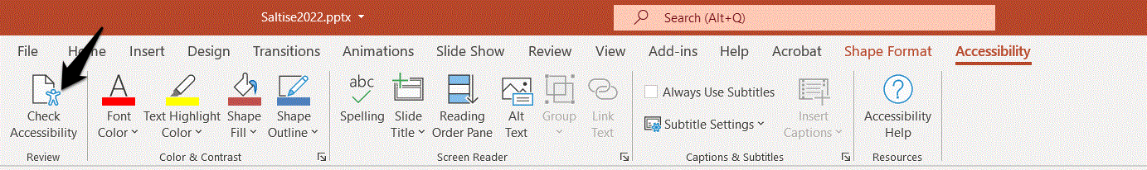
Accessibility Checkers for Word, PowerPoint…
The Microsoft Accessibility Checker ¹
  Is included in all Microsoft 365 programs
  Allows users to check the accessibility of their documents
Type “accessibility checker” into the search bar on top of …
Follow instructions in the panel on the right
¹ https://support.microsoft.com/en-us/office/make-your-content-accessible-to-everyone-with-the-accessibility-checker-38059c2d-45ef-4830-9797-618f0e96f3ab

Slide 5
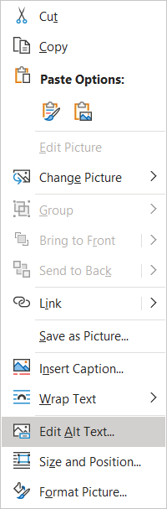
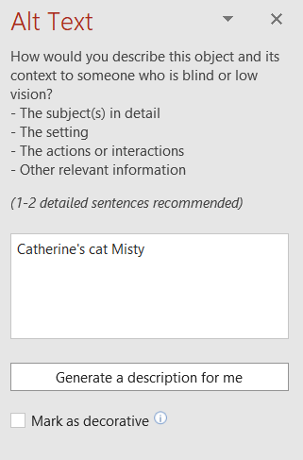
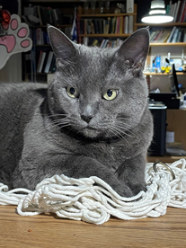
Providing Alt Text
Add alt text to all images, graphs, and tables
  Word
  PowerPoint
  Excel
Right click on an image

Slide 6

Captioning Videos
Convert audio and video content to use subtitles
  Automatic captions generated by AI
    Upload audio or video file to Microsoft Stream ¹
    Can be turned on and off
    May require editing (craptions)
      Unedited captions better than nothing
¹ Legault, A. (n.d.). From Zoom to Stream: How to upload and caption your recorded Zoom lecture. Dawson Faculty Hub. https://www.dawsoncollege.qc.ca/faculty-hub/wp-content/uploads/sites/182/From-Zoom-to-Stream-How-to-Upload-and-Caption-Your-Recorded-Zoom-Lecture.pdf

Slide 7
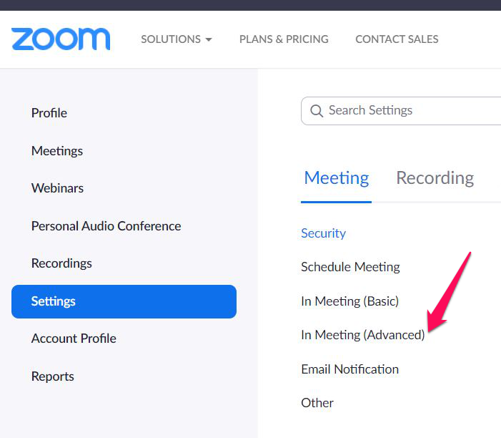
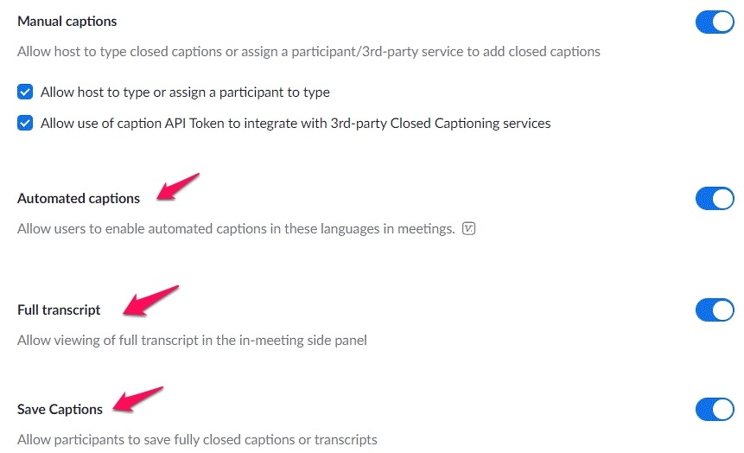
Captioning ZOOM
Create Zoom Automatic Captions and Transcripts
Log into your Zoom account

Slide 8
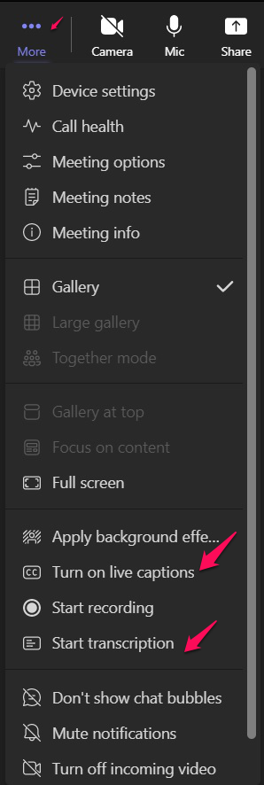
Captioning TEAMS
Create TEAMS automatic captions & transcripts
    Open TEAMS
      Go to the More three dots (…) on the top
        Click on “Turn on Live Captions”
        Turn on “Start Transcription”
    Tell you students to do this also!

Slide 9

PowerPoint available at Rebrand.LY/HavelFichten
MOOC: Basics of Inclusive Design for Online Education https://www.coursera.org/learn/inclusive-design
E-Access Concordia Project
https://adaptech.org/research/e-access-concordia-project/
Adaptech Research Network: www.adaptech.org
Alice Havel: ahavel@dawsoncollege.qc.ca
Catherine Fichten: catherine.fichten@mcgill.ca

