Slide 1

Universal Design for Learning: Canadian Perspectives
Let’s stop talking and start doing:
Implementing UDL in the AccessAbility Centre @ Dawson College
Montreal, QC
May 22, 2015

Slide 2
Presenters
Alice Havel
Susie Wileman
Courtney MacDonald
Agnes Zagury

Slide 3
Outline
Our Journey
UDL: Why now?
Implementing UDL: Facilitators
Implementing UDL: Barriers
Steps Taken
Next Steps
Feedback Mechanisms

Slide 4
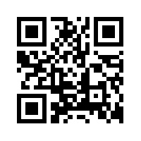
Engaging in conversation
Please feel free to share your thoughts and experiences with UDL here:
http://udljourney.forums.com

Slide 5


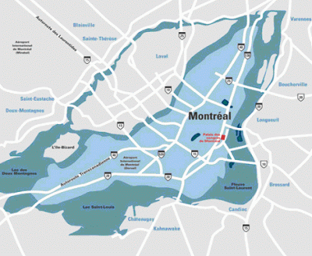

Let me tell you a story...
Start here...

Slide 6
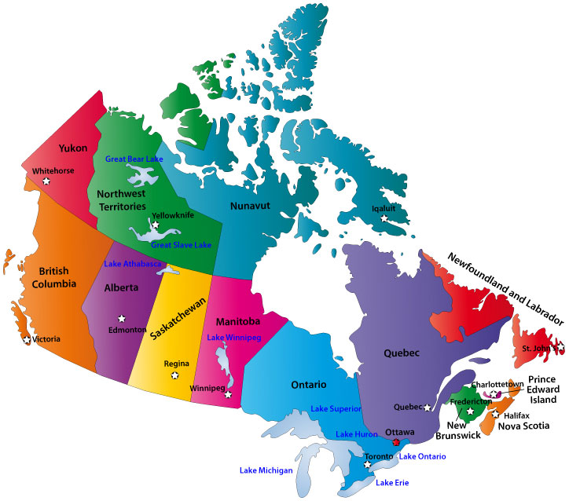
Where we are on this journey...

Slide 7
Where are you on this journey?

Slide 8

UDL: Why now?
Sustainability
Modeling our values
Faculty concerns
Moving away from the medical model
Policies & procedures
Socio-economic issues

Slide 9

Reflection
What is motivating you to make changes?

Slide 10
Implementing UDL: Facilitators
Sustainability
Support from management
Faculty Learning Community
Consultant
Self-determination

Slide 11
Implementing UDL: Facilitators
Culture of research
Technology
New faculty (younger demographic)
New staff (younger demographic)
Resource to faculty

Slide 12
Implementing UDL: Barriers
Service model
Habits
Time
Funding
Space constraints
Expectations
Anxiety
How?

Slide 13
Reflection
In your institution, are the facilitators and barriers any different?
How can you minimize the impact of these barriers?

Slide 14

Steps Taken
PD Opportunities
Reflection
Consultant

Slide 15
Steps Taken
Resources
Mission statement and values
Policies and procedures

Slide 16
Next Steps
More policies and procedures
Stakeholder feedback
Community buy-in

Slide 17
Next Steps
Practices
Communication (Website, Handbook)
IT support

Slide 18
Reflection
Are there critical steps that are missing?

Slide 19
Feedback mechanisms
Within the Student AccessAbility Centre
Students
Faculty
Administration and College Bodies

Slide 20
Reflection
When is the best time to get feedback? From whom and how?
How do your existing policies, procedures, and practices reflect the principles of UDL?

Slide 21

Continuing the journey...
Let’s stay in touch...
http://udljourney.forums.com
Notes:
Here we will provide info for the virtual space to add comments

Slide 22
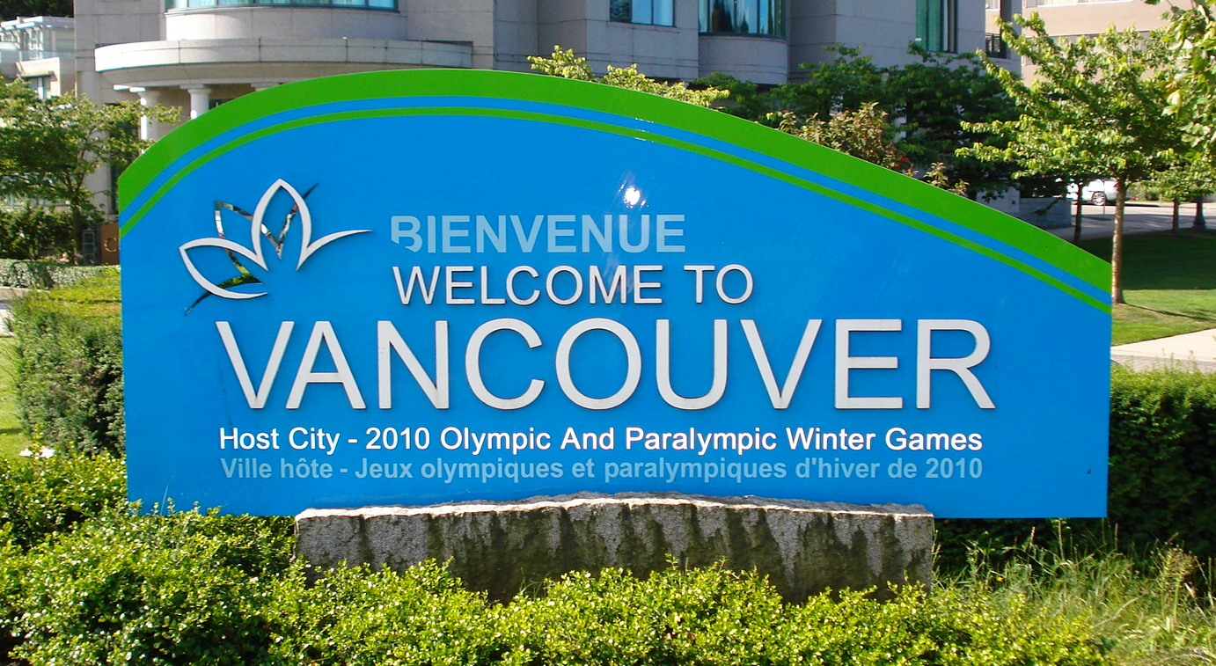

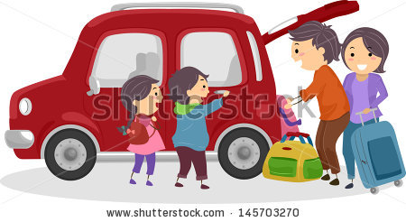
Where we want to go...
Finish here...

Slide 23
Contact information
Alice Havel ahavel@dawsoncollege.qc.ca
Susie Wileman swileman@dawsoncollege.qc.ca
Agnes Zagury azagury@dawsoncollege.qc.ca
Courtney MacDonald cmacdonald@dawsoncollege.qc.ca

Slide 24
Resources
Refocus: http://projectshift-refocus.org/
Reframing Disability, reshaping the provision of services.
Meghan Houghton, Durham College and Frederic Fovet, McGill University. Article published in the Fall 2012 CACUSS Communique magazine
https://meghoughton.wordpress.com/2012/11/29/reframing-disability-reshaping-the-provision-of-services/
Thornton, M and Downs, S. (2010). “Walking the Walk: Social Model and Universal design in the Disabilities Office. Journal of Postsecondary Education and Disability. Association on Higher Education and Disability: 23 (1), 74-80.

Slide 25
Resources
Disability service office websites to explore:
University of Arizona http://drc.arizona.edu/
University of Arkansas at Little Rock http://ualr.edu/disability/
Missouri State University http://www.missouristate.edu/disability/

