Slide 1





Small Fish in a Big Pond: A Canadian Perspective
Laura King, Catherine Fichten, Alice Havel,
Roch Ducharme, Alex Lussier, Mary Jorgensen
3rd Ed-ICT International Network Symposium
Tel Aviv, Israel, March 13, 2018

Slide 2
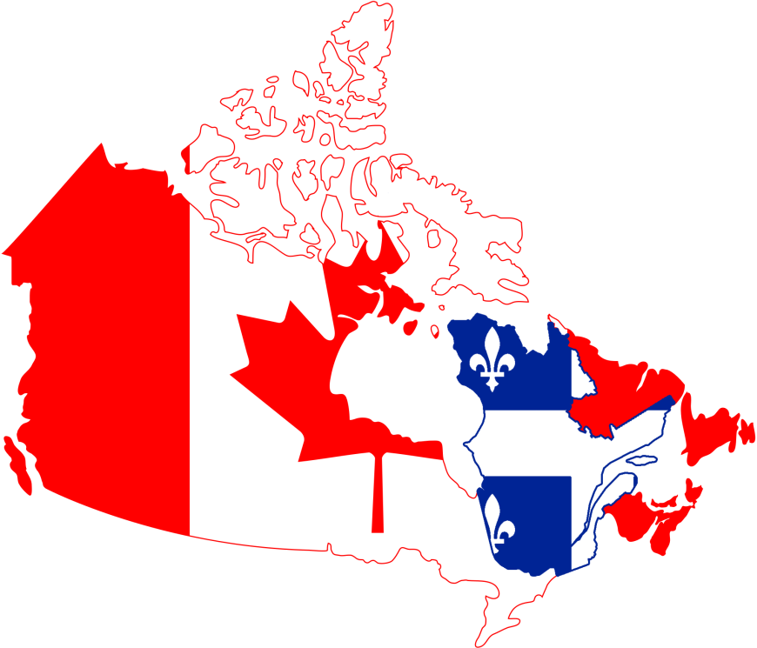
Question One
What approaches to new technology design and development for disabled students is happening within Canada?

Slide 3


Canadian Software
WordQ, SpeakQ, Thought Q
  Word prediction software
  Text-to-speech
  Speech recognition
  Research tool
ClockWork
  Administrative software
Notes:
ClockWork – early 2000s, administrative software (scheduling, data, accommodation letters), originally made to for the disability services at the post-secondary level, now used for other students services and used widely in the USA too

Slide 4


Quebec Software
Antidote
  Advanced correction and editing tool
Lexibar
  Word prediction software
    French
    English

Slide 5
Not-for-Profits:
Making, Sharing and Testing
Adaptech Research Network
  Software and mobile apps for…
Neil Squire Society
  Assistive technologies for…
TECLA
  Mobile apps for…

Slide 6
Current Trends in Canada
English
  Rely on American technology
French
  Can access French and Belgian technology
Current Trends in Canada
  Mobile learning
  Cloud computing
  MOOCs
  Online courses
  Webinars

Slide 7
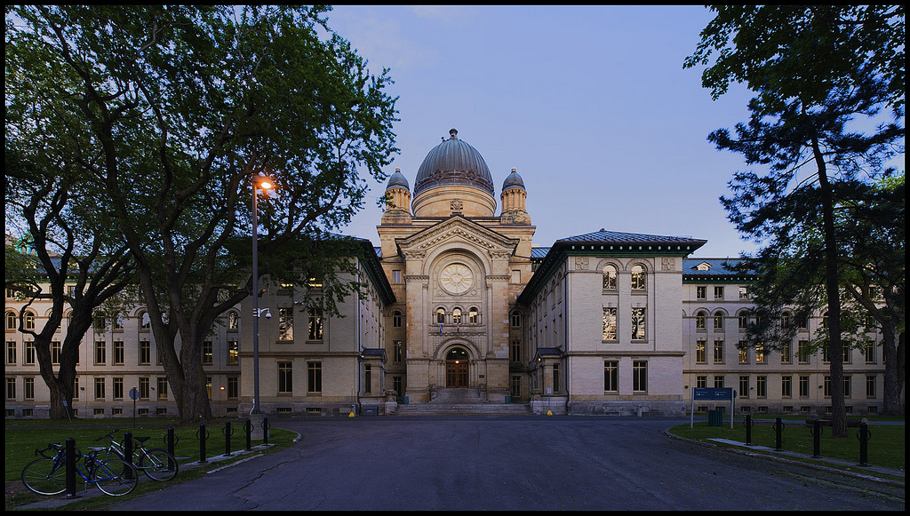
Question Two
What is our college doing for its disabled students in terms of procuring, developing, promoting, evaluating, designing etc. new technologies?

Slide 8

Procurement
Past
      Student funded directly
Present
      Funding on-campus labs
      Read and Write Gold online
Future
  Go virtual and create assistive-technology environments

Slide 9
Promotion,
Evaluation, Development and Design
  Promotion
    AccessAbility Centre
  Evaluation
    Dawson’s Adapted Technology Lab
    CRISPESH
  Development and Design
    Not at our institution

Slide 10
Our Research on this Topic
Experts versus students with LD
http://www.adaptech.org/sites/default/files/abInformationAndCommunicationTechnologyProfiles.pdf
Where we’ve been and where we’re going
http://www.adaptech.org/sites/default/files/abDigitaTechnologySpecialIssue.pdf
Notes:
Insert information here.

Slide 11
Contact Information
  Laura King
  laura.king@claurendeau.qc.ca
  Catherine Fichten
  cfichten@dawsoncollege.qc.ca
Alice Havel
  ahavel@dawsoncollege.qc.ca
Adaptech Research Network
  www.adaptech.org

Slide 12


