Slide 1


The ADHD Coach That’s in Your Smartphone
Legault, A., & Havel, A. (2021, March 6-14). The ADHD coach that’s in your smartphone [Conference presentation]. 36th Annual CSUN Assistive Technology Conference, Northridge, CA, United States.
Anick Legault & Alice Havel
In collaboration with​
Maegan Harvison, Mary Jorgensen, & Jill Budd
Adaptech Research Network and Dawson College​
36th Annual CSUN Assistive Technology Conference, March 6 – March 14, 2021

Slide 2
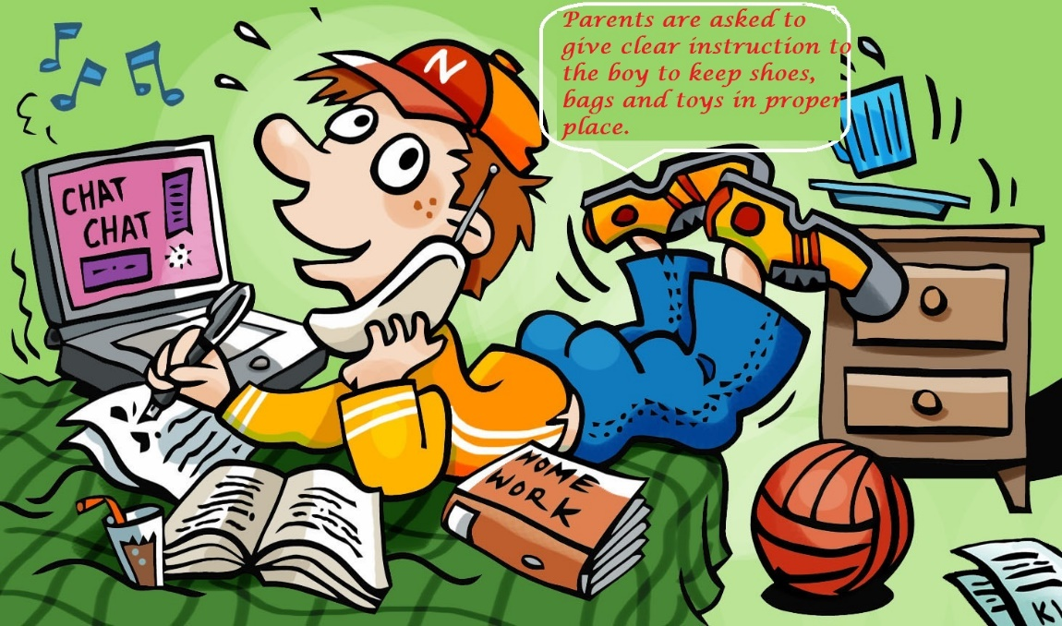
Presentation Objectives
Relevance and Main Characteristics of ADHD
Mobile Apps Study
    Schoolwork Apps
    Daily Living Apps
Take-Aways

Slide 3
Relevance of ADHD
Between 28% - 38% of post-secondary students with disabilities have ADHD¹
Poor academic performance²
  Lower grades
  Less likely to graduate
Isolating ADHD
¹Fichten, C., Jorgensen, M., King, L., Havel, A., Heiman, T., Olenik-Shemesh, D., & Kaspi-Tsahor, D. (2019). Mobile technologies that help post-secondary students succeed: A pilot study of Canadian and Israeli professionals and students with disabilities. International Research in Higher Education, 4(3), 35-50. https://doi.org/10.5430/irhe.v4n3p35
²Budd, J., Fichten, C., Jorgensen, M., Havel, A., & Flanagan, T. (2016). Postsecondary students with specific learning disabilities and with attention deficit hyperactivity disorder should not be considered as a unified group for research or practice. Journal of Education and Training Studies (JETS), 4(4), 206-216. https://doi.org/10.11114/jets.v4i4.1255

Slide 4
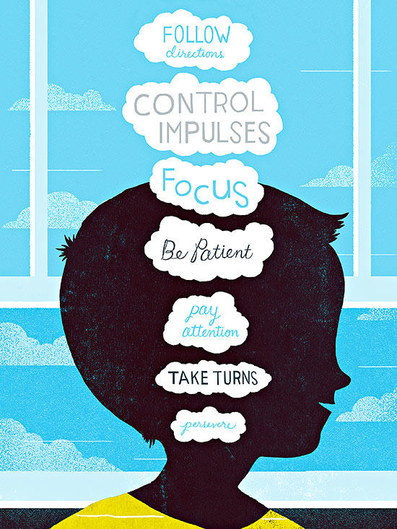
Main Characteristics of ADHD
Deficits in executive functioning
  Time management
  Organization
  Motivation
  Focus
Academic difficulties with
  Reading comprehension
  Lengthy writing assignments

Slide 5

Mobile Apps
99% of American college students own a smartphone¹
Advantages of mobile devices
  Device portability – always handy!
  User mobility – log in anywhere!
  In-class learning and pedagogical tool^{2, 3}
    Download useful apps, quizzes, polls, exams, sensitive questions, etc.
¹Seilhamer, R., Chen, B., Bauer, S., Salter, A., & Bennett, L. (2018). Changing Mobile Learning Practices: A Multiyear Study 2012–2016. EDUCAUSE. https://er.educause.edu/articles/2018/4/changing-mobile-learning-practices-a-multiyear-study-2012-2016
²King, L., Legault, A., & Lussier, A. (2020, Febraury 28). Exploring pedagogically sound practices for the use of smartphones. Profweb. https://www.profweb.ca/en/publications/articles/exploring-pedagogically-sound-practices-for-the-use-of-smartphones
³Profweb Editorial Team, & Legault, A. (2020, September 27). Video tutorials for teachers for the inclusive use of smartphones. Profweb. https://www.profweb.ca/en/publications/articles/video-tutorials-for-teachers-for-the-inclusive-use-of-smartphones

Slide 6
Focus of Study¹
Goal: Compile comprehensive list of apps
  For post-secondary students with ADHD
  Impact on academic success
  Directly support schoolwork
  Also support daily life demands
¹Fichten, C. S., Havel, A., Jorgensen, M., Arcuri, R., & Vo, C. (2020). Is there an app for that? Apps for post-secondary students with attention hyperactivity disorder (ADHD). Journal of Education and Training Studies, 8(10), 22-28. https://doi.org/10.11114/jets.v8i10.4995

Slide 7
Methodology
Examined 23 sources (2017-2020)
  Web search with Google Scholar
  ADDitude Magazine
  2 web sites (CADDRA, CADSPPE listserv)
  4 ADHD Facebook groups
  App Store and Google Play Store (Canada)
  Adaptech focus group study (2018-2019)

Slide 8

Limitations of Study
Compilation of Apps
  Some only mentioned once
Did not provide
  Number of downloads
  Ratings/satisfaction scores
Prices of apps
  Most free or <$10

Slide 9
Results
Annotated list of apps from 23 sources¹
  Total of 131 apps
  All available (on August 1st, 2020)
  Frequency each mentioned
    Range of 1-9
  Comprehensive descriptions
¹Jorgensen, M., Arcuri, R., Vo, C., & Fichten, C. (2020, August). Comprehensive list of apps related to the academic performance of post-secondary students with ADHD. Adaptech Research Network.

Slide 10
Schoolwork Apps
Most common categories
  Task management (e.g., Evernote, Microsoft To Do)
  Focusing + distraction management (e.g., Freedom)
  Time management (e.g., RescueTime/ Time Timer)
  Organization (e.g., Dropbox)
  Literacy (e.g., Read & Write)
  Text-to-speech (e.g., Voice Dream Reader)

Slide 11
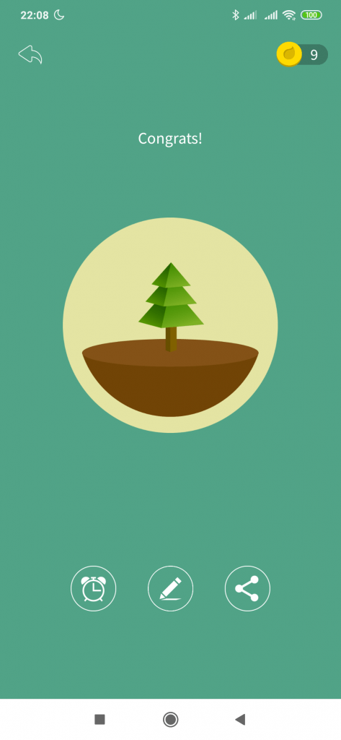


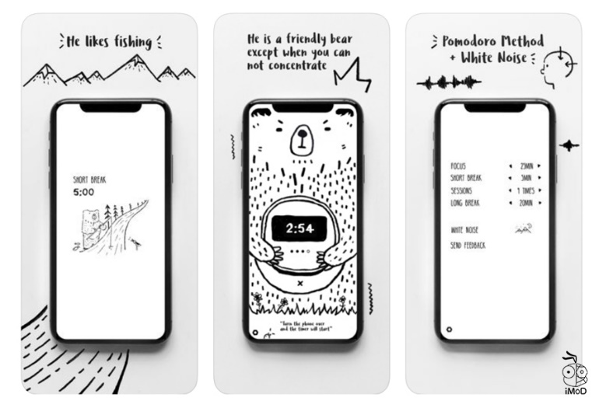


The Stars of Schoolwork Apps
Maegan’s choice from the list:
Microsoft To Do
Forest
Quizlet
White noise/Bear Focus Timer
Boosted
Mindnote 5
Voice dream reader
iStudiez

Slide 12

Daily Living Apps

Slide 13
Daily Living Apps – Cont’d
Most common categories
  Budget and financial tracking (e.g., Mint, YNAB)
  Email management (e.g., Boomerang Mail, Unroll.Me)
  Wake-up (e.g., Alarmy, FreakyAlarm)
  Sleep monitoring (e.g., Sleep Cycle)

Slide 14

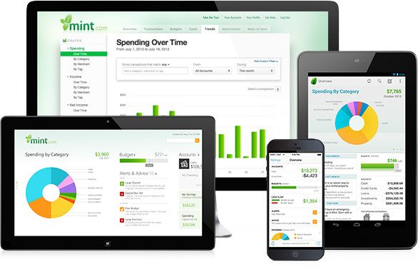

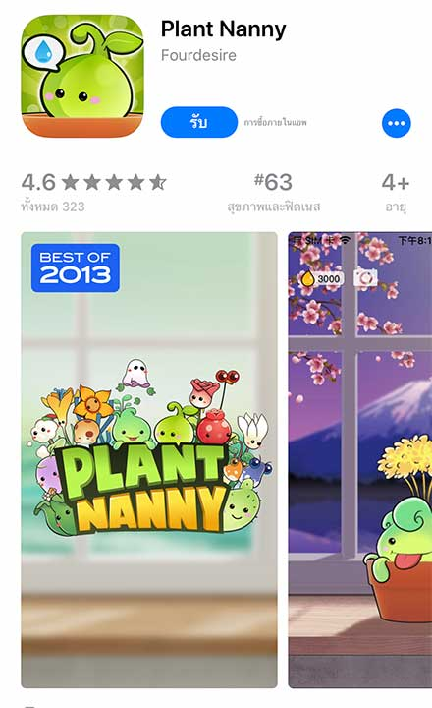

The Stars of Daily Living Apps
Maegan’s Choice From the list:
Mint
Owaves
Sleep cycle
Relax melodies
Maegan’s addition to the list:
Plant nanny
Headspace and/or Calm

Slide 15
What’s happened since?
Study: Use of technologies for schoolwork¹
  Online questionnaire Fall 2020
  237 Canadian university and college students
    With and without disabilities
  Data presently being analysed
    Students with ADHD (primary focus)
¹Fichten, C., & Budd, J. (2021). [What apps do students with ADHD and nondisabled students use and like?]. Unpublished raw data.

Slide 16
Apps Tried by Students
Participants with ADHD but no LD n = 35 |  | All participants with ADHD n = 57 |  | All nondisabled participants n=74
% | name of app | % | name of app | % | name of app
63% | Dropbox | 65% | Dropbox | 59% | Dropbox
57% | Google Calendar | 61% | Google Calendar | 57% | Google Calendar
31% | Evernote | 30% | Evernote | 39% | Quizlet
26% | Quizlet | 30% | Quizlet | 18% | Evernote
17% | To Do / Wunderlist | 25% | Read & Write | 8% | To Do / Wunderlist

Slide 17
Apps Liked by Students
Participants with ADHD but no LD n = 35 |  | All participants with ADHD n = 57 |  | All nondisabled participants n=74
% | name of app | % | name of app | % | name of app
43% | Google Calendar | 47% | Google Calendar | 45% | Google Calendar
34% | Dropbox | 35% | Dropbox | 36% | Dropbox
20% | Quizlet | 25% | Quizlet | 32% | Quizlet
11% | Read & Write | 18% | Read & Write | 8% | Evernote
9% | Evernote | 7% | Evernote | 4% | Pomodoro Timer & To Do List

Slide 18
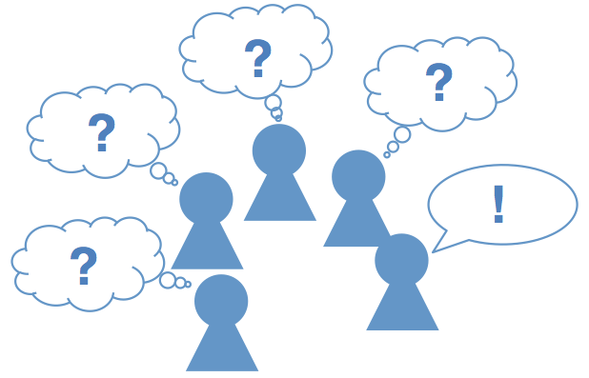
What’s Next?
ADHD Interviews
  Questions
    Use of Apps for academic work
      In-class
      Out-of-class
    Level of satisfaction
    Wish list

Slide 19
Take-Aways
Most apps work across various devices
Importance of daily life apps
Technology rapidly changing
Same apps tried and liked across groups
Opportunities needed to explore apps

Slide 20


Thank you! Questions?
Adaptech Research Network: http://www.adaptech.org/​
Anick Legault: aclegault@dawsoncollege.qc.ca
Alice Havel: ahavel@dawsoncollege.qc.ca​

