Slide 1




Sleep Quality in Post-Secondary Populations with and Without Disabilities
Wing, S., & Costin, G. (2022, October 26). Sleep quality in post-secondary populations with and without disabilities [Invited speakers]. Adaptech and the Sleep and Aging Lab Groups, Montreal, QC, Canada.
Samantha Wing & Georgiana Costin
Presentation to the Adaptech and the Sleep and Aging Lab Groups
October, 26, 2022

Slide 2
Research Team
Fichten, Catherine
Asuncion, Jennison
Bailes, Sally
Costin, Georgiana
Creti, Laura
De Saedeleer, Sylvie
Havel, Alice
Jorgensen, Mary
Libman, Eva
Paul, Louise
Rizzo, Dorrie
Wileman, Susie
Wing, Sam

Slide 3

Presentation Objectives
Questions to address
Goals
Methods
  Qualitative study
    Phase 1
    Phase 2
    Hypotheses
  Quantitative study

Slide 4

Questions to Address
  What has been the impact of Covid-19 sleep related experiences
    On "back to face-to-face teaching, learning and working"
  What are the positive and negative outcomes
      For whom (gender, age, disability, group)
        Student, faculty, other staff
  Given "back to face-to-face" how can
    Positive outcomes be maximized
    Negative outcomes be mitigated

Slide 5

Goals
Examine
  The "past" (remote learning)
  The "present" (face-to-face)
Identify
  Profiles of those at risk for negative sleep and well-being
  Factors
      Associated with increased risk
      That are protective and/or enhance resilience
Develop recommendations

Slide 6
Methods: Qualitative Study
Three phases
  Individuals who were present
    During both remote and face-to-face learning
      Phase 0: email study of focus group participants
      Phase 1: consist of focus groups
      Phase 2: LimeSurvey comprising validated questionnaires
We will study the following post-secondary groups
  Students: (1) with (2) without disabilities
  Faculty: (1) with (2) without disabilities
  Non-teaching staff: (1) with (2) without disabilities

Slide 7

Phase 0: Email Study - 1
Before the Zoom focus group
  Participants will answer questions by email
  Quality of sleep during remote learning semester (10-point scale)
  Quality of sleep during in-person learning/working (10-point scale)
  5 Morningness/Eveningness questions (Chelminski et al.,2000)

Slide 8
Phase 0: Email Study -2
Hypothesis
  Eveningness chronotypes will have significantly better sleep quality during the remote than the in-person semester
    Especially true of students and faculty
  Morningness chronotypes will have significantly better sleep quality during the in-person semester than eveningness chronotypes

Slide 9

Phase 1: Focus Groups
Research Ethics Board Certificate obtained
6 Zoom sessions
60 minutes
6-10 individuals for each of the 3 groups
  Prior to the focus group meeting
    Participants will be given the questions and the consent form

Slide 10
Phase 1: Focus Groups (cont’d)
Questions
  Positive & negative contributors to sleep & well-being
    During the Covid-19 era
    During the return to face-to-face teaching, learning and working,
    Impact of the remote learning period on face-to-face experiences
  Responses will be coded
    Used to formulate Phase 2 open-ended LimeSurvey questions
Notes:
We will ask you the following questions.
What were positive and negative contributors to sleep and well-being during the COVID-19 era?
What were positive and negative contributors to sleep and well-being during the return to face-to-face teaching, learning, and working?
What were positive and negative impacts of the remote learning period on the current face-to-face experience?

Slide 11

Phase 2: LimeSurvey
Self-report: listing of participants' disabilities
Questionnaires & questions that inquire about
  Present: trait measures
  Gender, disability, personality, anxiety, distance from school
Past & present evaluations
  Sleep-related
  Well-being
  Chronobiology
  Computer-related comfort
  Open-ended questions
    Family, work circumstances, health, topics from phase 1 focus groups
Banerjee, M., Lalor, A. R., Madaus, J. W., & Brinckerhoff, L. C. (2020). A survey of postsecondary disability service websites post ADA AA: Recommendations for practitioners. Journal of Postsecondary Education and Disability, 33(3), 301-310.

Slide 12
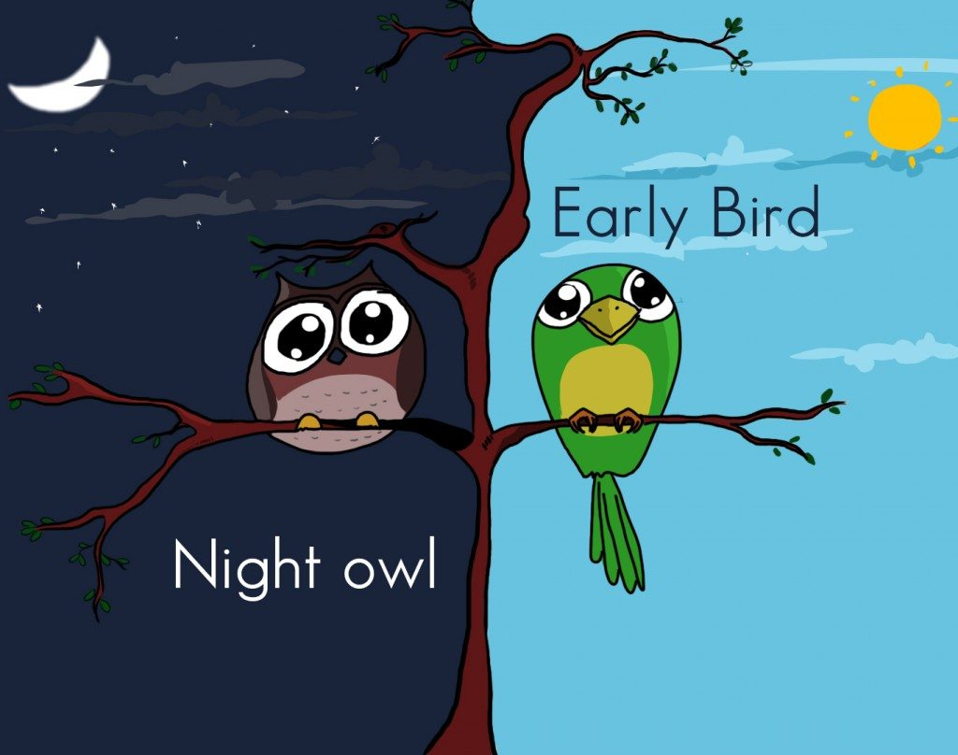
Quantitative Email Study: Goals
Examine
  The "past" (remote learning/working)
  The "present" (in-person learning/working)
Identify
  "Early birds" (Morningness)
  "Night owls" (Eveningness)
Analyze how morningness/eveningness chronotypes impact individuals in different contexts

Slide 13
Qualitative Study: Hypotheses
Research is primarily descriptive
Phase 2: we predict that individuals with
  Those who score high on Neuroticism and Trait Anxiety
    More sleep & well-being problems both past & present
  Problem family situations (e.g., young children, elderly parents)
    Better sleep and well-being during the present than the past
  High Extraversion will have worse scores during the past than the present
    On sleep, depression, anxiety, quality of life

Slide 14
Thank You! Questions?
?

