Slide 1





Are AI-Based Virtual Assistants Such as Siri, Alexa, and Google Assistant Ready for College?
Fichten, C., Jorgensen, M., Arcuri, R., Vo, C., Budd, J., Legault, A., & Havel, A. (2021, June 3). Are AI-based virtual assistants such as Siri, Alexa, and Google Assistant ready for college? [Virtual poster presentation]. 10th Annual SALTISE Conference, Montreal, QC, Canada.
Catherine Fichten, Mary Jorgensen, Rosie Arcuri, Christine Vo, Jillian Budd, Anick Legault & Alice Havel
Adaptech Research Network and Dawson College
10th Annual SALTISE Conference, June 3, 2021

Slide 2
Abstract
How are virtual assistants used to do schoolwork?
  Siri, Google Assistant, Alexa, Bixby
Method: surveyed college and university students
    121 students with and 51 without disabilities
    Goal: find out how students use virtual assistants to do schoolwork
  Results (LimeSurvey)
    2% - 15% of students used virtual assistants to do schoolwork
    Mainly for calendar alerts, internet research, & dictionary
  Conclusions
    Are Siri, Google Assistant and Alexa ready for college? “No!”

Slide 3
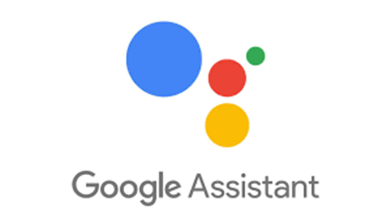
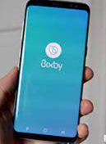

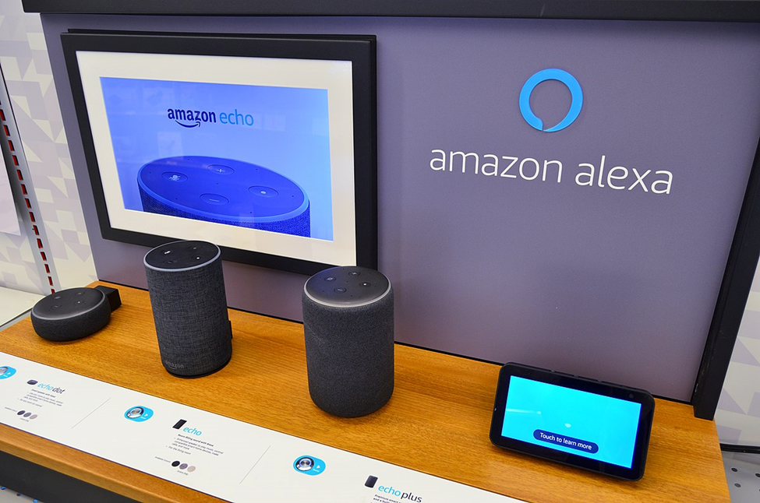
Method: 121 Students with & 51 Without Disabilities
Did you use a smartphone to do schoolwork?
  If yes, which type of smartphone(s) did you use? (iPhone, Android, Other)
Did you use a tablet to do schoolwork?
  If yes, which type of tablet(s) did you use? (iPad, Android, Other)
If you used __________ for schoolwork, what school related tasks did you use this for?
  Siri
  Google Assistant
  Alexa
  Bixby (Samsung)

Slide 4
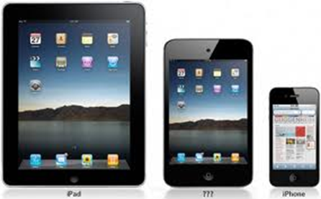
Results 1
Overall, little use made of these
  Similar proportions of the 2 groups
  More smartphones (58%) than tablets
  63% of smartphones & 82% of tablets are Apple
  More Apple than Android
Virtual assistant | Students with a disability | Students without disabilities
Google Assistant | 15% | 8%
Siri | 12% | 12%
Alexa | 2% | 4%
Bixby | 2% | 2%

Slide 5

Results 2
  Mainly used for
    Calendars / scheduling / alerts, internet / research, dictionary
Activity | Siri | Google Assistant | Alexa | Bixby | Total
Schedule/calendar/alerts/reminders | 9 | 8 | 3 | 1 | 21
Internet/research | 2 | 9 |  | 2 | 13
Dictionary/definitions | 6 | 2 | 2 |  | 10
Spelling | 4 | 1 | 2 |  | 7
Timer | 1 | 2 |  |  | 3
Read books |  | 2 | 1 |  | 3
Calculate | 1 |  | 1 |  | 2
Translate | 2 |  |  |  | 2

Slide 6

Conclusions
Regrettably, virtual assistants are not yet ready for college!
Adaptech Research Network: www.adaptech.org
Catherine Fichten: catherine.fichten@mcgill.ca

