Slide 1



“Chrome Browser Extensions for Instructors: The Under-Utilized Productivity Tool”
Arcuri, R., Vo, C., Fichten, C., Harvison, M., & Vasseur, A. (2022, June 3). Chrome browser extensions for instructors: The under-utilized productivity tool [Conference presentation]. 2022 SALTISE Conference, Montreal, QC, Canada.
Rosie Arcuri, Christine Vo, Catherine Fichten,
Maegan Harvison, Abi Vasseur
Adaptech Research Network
Saltise 2022
June 03, 2022

Slide 2
What Is A Browser Extension and Why Do You Need These?
Programs that change the browser experience by
  Adding features to enhance web site functionality
    Zoom(size) and other settings
    Remove unwanted website elements
      E.g., pop-up ads, auto-play for online videos
  Linking to external service
        Productivity and organizational tools

Slide 3



Organization
OneNote Web Clipper
  Feature rich Microsoft tool to annotate, comment, web pages
Google Keep
  Save websites, notes, to-do lists
  Access these anywhere
Pocket - save files, sites
  Access on computer and mobile

Slide 4

What Is an Extension? (2)
Linking to external services
  Spell and grammar checkers
  Productivity and organizational tools
  Text-to-speech and other reading tools

Slide 5


Acquiring Materials
Evernote Web Clipper
  Annotate, highlight
Google Scholar
  Quickly find articles

Slide 6

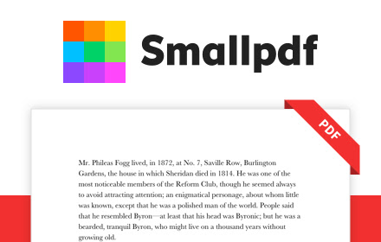

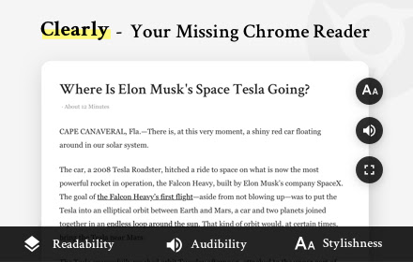
Preparing Materials
InsertLearning
  Add elements (question, video etc.)
    To websites, to an online article
SmartPDF
  Adobe Pro alternative
  Rearrange or add pages
Print Friendly & PDF, Clearly Reader
  Remove ads, quickly save web article as PDFs

Slide 7



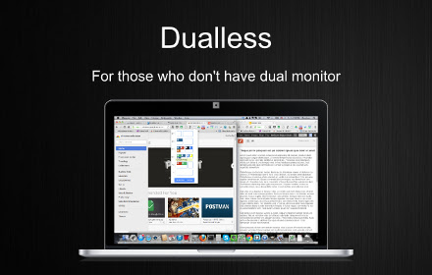
Miscellaneous
Loom, Vmaker, Screenity
  Create videos
  Create screen recordings
Dualess
  Mimics two monitors on one screen

Slide 8
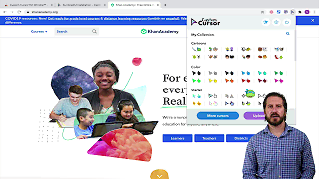
Video Resource
Resources
  Video: Must-Have Chrome Extensions for Teachers
  Safety: Assessing Safety Extension

Slide 9
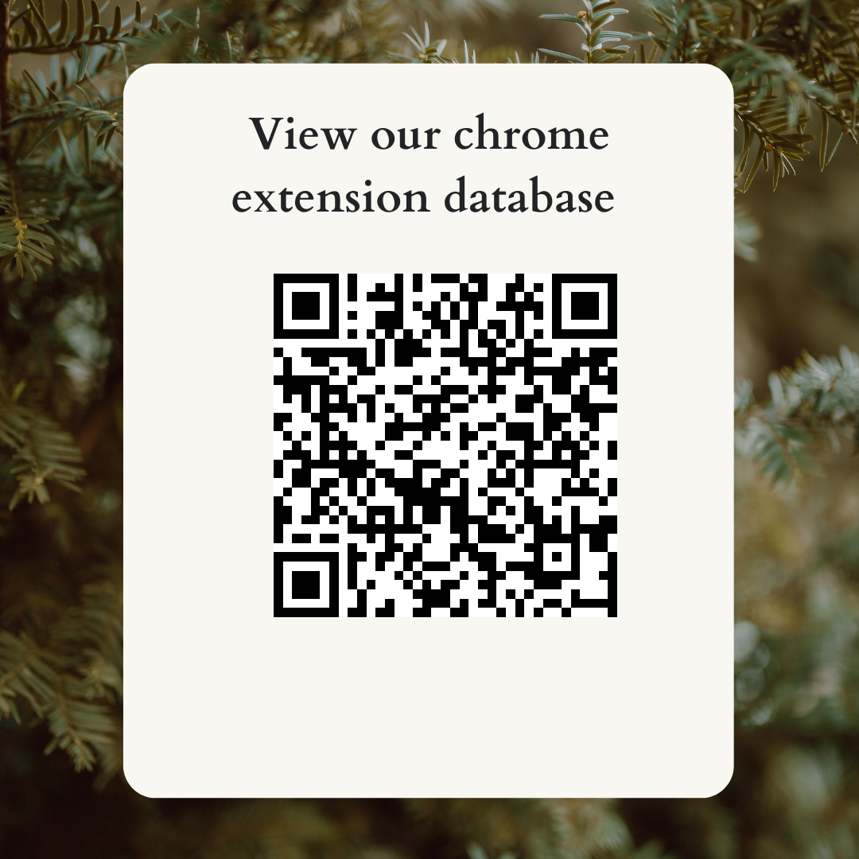
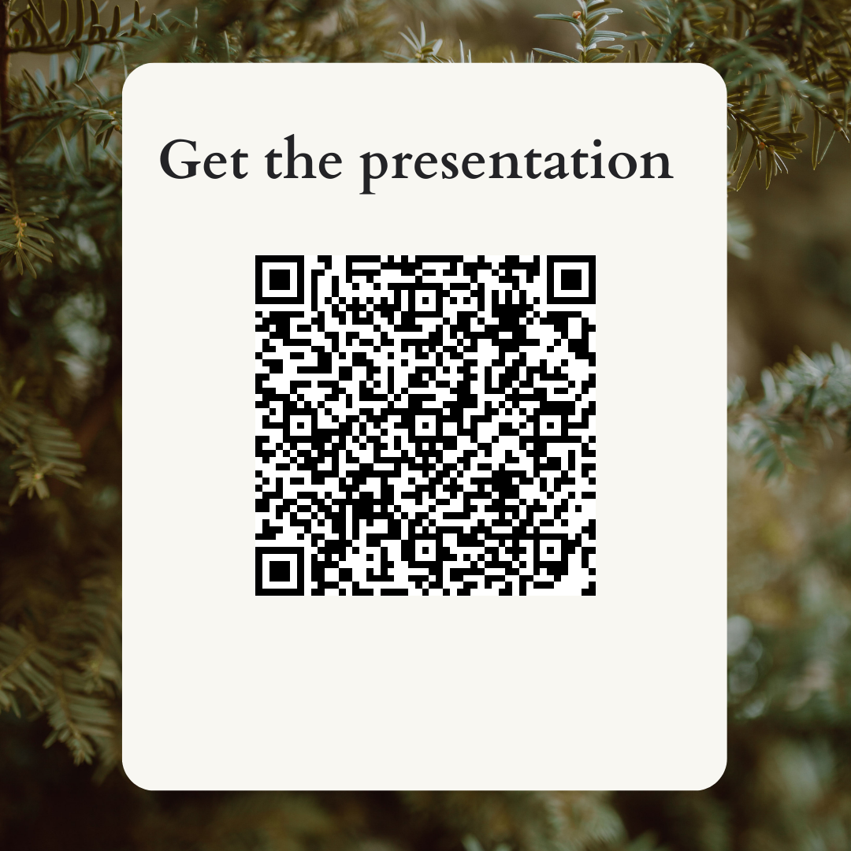
Thank You!
1. View our Chrome extension database
2. Get the presentation
Adaptech Research Network: www.adaptech.org
Rosie Arcuri: rosie.arcuri@mail.mcgill.ca
https://adaptech.org/fandi/products/operating-system/chrome/?v=categories
Saltise 2022 - Chrome Extensions for Instructors presentation

