Slide 1






Parasomnias and Other Negative Sleep Related Phenomena Among Post-Secondary Students With and Without Disabilities
Libman, E., Fichten, C., Creti, L., & Bailes, S. (2023, September 5). Parasomnias and other negative sleep related phenomena among post-secondary students with and without disabilities [Invited speakers]. Psychosocial Rounds at the Jewish General Hospital, Montreal, QC, Canada.
Eva Libman^{1,2,3} Catherine Fichten^{1,2,3,4,5} Laura Creti^{1,2,3} Sally Bailes^{1,2,3}
Alice Havel^{4,5} Bianca Zlotea^{4,5} Georgiana Costin^{1,5} Mary Jorgensen⁵
¹McGill, ²LDI, ³CIUSS, ⁴Dawson College ⁵Adaptech Research Network
Psychosocial Rounds, Montreal, September 5, 2023
https://shorturl.at/mxDGX
Notes:
Scottish Prayer:
From ghoulies and ghosties
And long-leggedy beasties
And things that go bump in the night,
Good Lord, deliver us!

Slide 2
Team Members
Adaptech Research Network
  Post-secondary students with and without disabilities
    Focus on academic success
  JGH Sleep Team
    Clinical and research
    Focus on sleep and sleep disorder

Slide 3

Overview
Understanding parasomnias
Our research
Preliminary pilot data

Slide 4
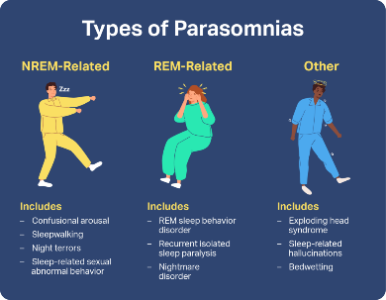
What Are Parasomnias?
During sleep the brain cycles
  Wakefulness
  NREM sleep
  REM sleep
Parasomnias
  Classified according to whether they emerged from NREM or REM sleep
  Occur when transitions between these stages are incomplete
People are
  Amnesic for the content from NREM parasomnias
  Usually recall that from REM

Slide 5
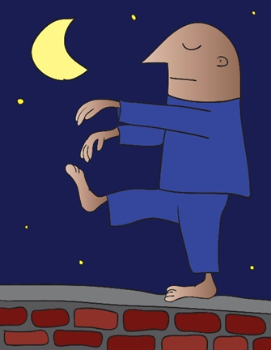
What Are Parasomnias?
NREM-Related Parasomnias
    Confusional arousals
    Sleepwalking
    Sleep talking
    Sleep terrors
    Sleep-related eating disorder
    Sexsomnia (sexual act during sleep)

Slide 6
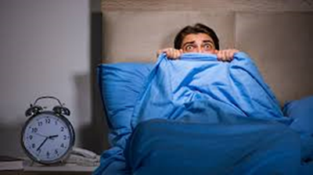
What Are Parasomnias?
REM-related parasomnias
    Nightmare disorder
    REM behavior disorder
    Recurrent sleep paralysis

Slide 7
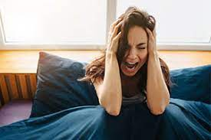
What Are Parasomnias?
Parasomnias emerging in either sleep phase
    Exploding head syndrome
    Sleep-related hallucinations (hypnogogic/hypnopompic)
    Sleep enuresis
    Sleep related leg cramps
    Sleep related bruxism
    Abnormal swallowing

Slide 8

Present Study
FRQS funded project
  Catherine, Eva, Laura Creti, Sally Bailes, Alice Havel
  Descriptive study
Goal: find out, in a post-secondary population
    About parasomnias
      Prevalence, impact, coping strategies
      Predictors
        Resilience and susceptibility
        Students with and without disabilities

Slide 9
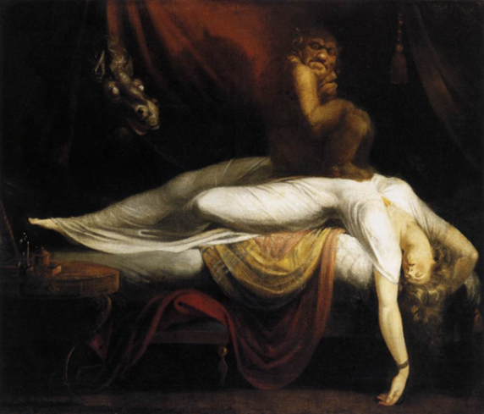
Where Ideas Came From
I gave a talk to students
“I never told anyone. I thought I was crazy!”
Students’ examples
  Why I couldn't lose weight
    Sleep-related eating disorder
  Praying to Mother Teresa
    Hypnopompic hallucinations
    Recurrent sleep paralysis
  A modern exorcism
    Pavor nocturnus (Sleep terrors)

Slide 10

Our Research
      As Eva mentioned we are interested
            Prevalence, impact, coping strategies
            Predictors: resilience and susceptibility
        Hypotheses: susceptibility
            Sleep deprivation
            “Poor sleepers”
            Multiple different parasomnias
            Psychological disorders
            ADHD
        Hypotheses: resilience = ???
Now: ready to launch project
  Waiting for ethics

Slide 11

Advisory Board
Two 1 hr. Zoom meetings with experts
  Outside opinions
Animator, 2 note takers
Research team were “flies on the wall”
Questions
  What are your thoughts concerning parasomnias and other negative sleep-related phenomena?
  What information do you think we need to gather from post-secondary students to
      Understand the phenomena
      Ultimately make recommendations

Slide 12

Curating English and French Validated Questionnaires
Literature search (French Google, Érudit)
Email colleagues
Email scholars who used the French version
Managed to get most measures BUT
  Different French versions differed from each other
  Colleagues said they used the measure but it was not validated
  Etc. etc.
  Had to translate two measures ourselves (DeepL really helped)

Slide 13
Parasomnia Measures
    Munich Parasomnia Screening (MUPS): 21 items
      During the past year, how often did you experience the following
        0= never to 6= very often If ≥ 3 then
          How disturbing was this? 1= not at all to 10 = very disturbing
          What did you do about this?
    Paris Arousal Disorders Severity Scale: 17 items
  During the past year, how often did you exhibit the following
        0= never, 1 = sometimes, 2= often If ≥ 1 then
          How disturbing was this? 1= not at all to 10 = very disturbing
          What did you do about this?

Slide 14

Other Measures
    Insomnia Severity Index
    Chronobiology: Reduced Morningness-Eveningness Scale
    Eysenck Personality Questionnaire (EPQ-RA: Neuroticism)
    Sleep Questionnaire
    Sleep Symptom Checklist
    Quality of Life Enjoyment and Satisfaction
    Hospital Anxiety and Depression Scale (HADS)
    Demographics & disability
    Anything else?

Slide 15

Method
  Administer 2 linked surveys
  Offer Amazon gift cards ($30)
  Sample
    Email participants in our data bank (2210 students since 2013)
    Current students or student during the past 5 years
      Past experience
        Many emails don’t work any more
        Some students not interested
        Expect 20% response rate (approx. 400 participants)

Slide 16
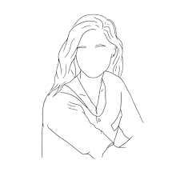
Preliminary Pilot Data: Participant 1
Participant 1: 25 year old female student
  Nightmare disorder
    MUPS item 13. During the past year, how often did you experience frightening dreams and nightmares: 6 = very often
  Confusional awakenings
  MUPS item 17. Upon waking, completely confused / difficult orientation / slowed speech: 4 = sometimes
  Other
    MUPS item 8. Teeth grinding during the night: 5 = often

Slide 17

Preliminary Pilot Data: Participant 1
Context
    Sleeps 12 hours during the night plus a 2-hour nap daily
Severe daytime fatigue/sleepiness (despite many hours sleeping)
Concentration and cognitive function appear unimpaired
Competitive sports & social activities have become limited
Perceives she has more energy in the summer
Uses bright light exposure

Slide 18
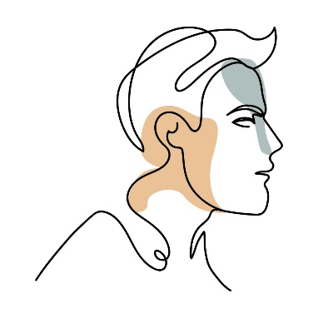
Preliminary Pilot Data: Participant 2
Participant 2: 22-year old male student
  Sleep-related movement disorder
  MUPS item 1: leg or body twitches that occur suddenly and unintentionally when falling asleep, often with the sensation of falling; 5= often
  Confusional awakenings
  MUPS item 17; Upon waking, completely confused/difficult orientation, slowed speech; 4=sometimes
  Other
  MUPS item 8: Teeth grinding: 6=very often
  MUPS item 5: Auditory/ visual illusions: 4=sometimes
  MUPS item 13: Nightmare disorder frightening dreams and nightmares; 4=sometimes

Slide 19
Preliminary Pilot Data: Participant 2
Context
Main complaint was overwhelming daytime fatigue
    Interfered with ability to complete assignments (although good student)
Relatively frequent nightmares & vivid dreams reported as unpleasant
    But not distressed by these
    Learned to wake himself up from these
    Then walk around to calm himself down & return to bed
Also a constitutionally long and delayed sleeper
    Contributed to sleep deprivation

Slide 20
Preliminary Pilot Data
Context
Main complaint was overwhelming daytime fatigue
    Interfered with ability to complete assignments (although good student)
Relatively frequent nightmares & vivid dreams reported as unpleasant
    But not distressed by these
    Learned to wake himself up from these
    Then walk around to calm himself down & return to bed
Also a constitutionally long and delayed sleeper
    Contributed to sleep deprivation

Slide 21
Our Parasomnia Story So Far
Importance of stakeholder experts for diverse viewpoints
Bilingual studies are difficult
More than one parasomnia may be common
Importance of subjective perception as well as objective score

Slide 22

Questions
PPT available at: https://shorturl.at/mxDGX
Eva Libman: eva/libman@mcgill.ca
Catherine Fichten: catherine.fichten@mcgill.ca
Laura Creti: laura.creti@mcgill.ca
Sally Bailes: sally.bailes@mcgill.ca
Alice Havel: ahavel@dawsoncollege.qc.ca

