Slide 1



The Use of Browser Extensions as AT:
Are We There Yet?
Arcuri, R., Vo, C., Fichten, C., Jorgensen, M., Harvison, M., & Vasseur, A. (2022, March 15). The use of browser extensions as AT: Are we there yet [Conference presentation]? 37th Annual CSUN Assistive Technology Conference, Anaheim, CA, United States.
Rosie Arcuri, Christine Vo, Catherine Fichten, Mary Jorgensen, Maegan Harvison and Abi Vasseur,
Adaptech Research Network
CSUN Assistive Technology Conference
March 15, 2022

Slide 2
Agenda
What are chrome extensions
How do you download chrome extensions safely
Chrome extensions for reading, writing, note taking, productivity, alternative mice/ keyboard
An alternative for assistive technology (AT)

Slide 3

Introduction
Google Chrome is the most popular browser in North America
Most students with disabilities, especially those with ADHD, mental health and LD chose not to use AT’s
  Cost
  Fear of being singled out
  Lack of training

Slide 4

This Initiative
180 relevant extensions compiled
100 extensions deemed safe
  Updated in 2019 or later
75 extensions tested
  Unique function
  Popularity
  Customer reviews

Slide 5
What Is an Extension?
Programs that change the browser experience by:
  Adding a function
    Display: background color, text size, remove adds & distractions
    Website and tab navigation: use the keyboard or mouse to alter navigation

Slide 6

What Is an Extension? (2)
Linking to external services
  Spell and grammar checkers
  Productivity and organizational tools
  Text-to-speech and other reading tools

Slide 7
Safety Tips
Is this extension from a developer that is a trusted source?
Is the developer's website consistent with the information on extension page on the Google Chrome store?
Are the extension's permission requests consistent with the features of the extension?
  Source: Assessing Safety Extension

Slide 8

Safety Tips (2)
Does the extension's description or website explain why they need those permissions?
Does the extension have a privacy policy, and am I comfortable with how the data is being used under the privacy policy?

Slide 9

How to Install an Extension
Sign into your Chrome (Gmail login)
Open the Chrome Web Store.
Search for an extension
Click Add to Chrome.
If prompted, click Add extension
(Source: Chrome Webstore)

Slide 10
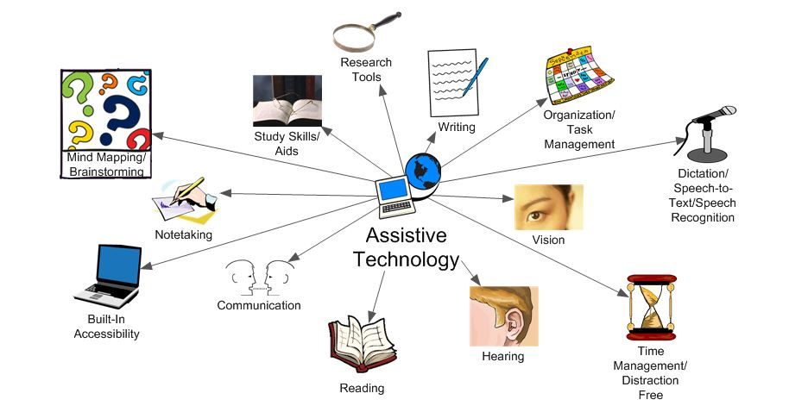
What Is Assistive Tech (AT)

Slide 11

How Are Extensions Different Than AT?
Often free or inexpensive
Used by the general public
Simple or complex
May require many extensions to replace comprehensive AT program
Information not always available
Minimal training

Slide 12

Comprehensive Literacy Tools
$99 annually
  Compared to $0-60
Comprehensive tools
  Common tools found in other extensions
  Uncommon tools such as OCR and picture dictionaries

Slide 13

Comprehensive Literacy Tools - Examples
  Read&Write: word prediction, highlight protection, summarize text
  Helperbird: most comprehensive with content, display, navigation, and other disability specific features

Slide 14

Reading
Common features
  Change text size, color, spacing and background
  Text-to-speech
  Removing distractions

Slide 15


Reading (2)
Extensions
  Clearly Reader
  Helperbird
  PrintFriendly and PDF

Slide 16


Writing
Spell and grammar checker
  Grammarly is most common & free
  Microsoft editor
Improve writing
  QuillBot: summarizing and paraphrasing

Slide 17

Writing (2)
Dictation – speech-to-text
  Voiceln: works in most textboxes including docs, and outlook
Text-to-speech (review)
  Speechify and Clearly reader stay on the site
  Read&Write and Kami move to new platform, more complex but paid

Slide 18

Writing (3)
Dictionary
  Regular and picture dictionary
    Dictionary Lookup
    Read&Write
Word prediction
  Read&Write

Slide 19

Note-Taking
Common features
  File management
  Notes websites
  Save screenshots
  Annotate on files (web, pdf, screenshots)

Slide 20



Note-Taking (2)
Extensions
  Evernote Web Clipper – most comprehensive
  OneNote Web - no annotations
  Google Keep - simple but effective

Slide 21

Productivity
Organize documents
  Google Keep, OneNote Web Clipper, Evernote Web Clipper all work very well
Simplified view
  Clearly Reader, Print Friendly and PDF

Slide 22


Productivity (2)
Timers
  Marinara - simple and free
  BlockSite - paid but offers series of timers
To do lists / project management tools
  Google Keep - basic checkbox
  Todoist

Slide 23


Productivity (3)
Website blockers
  BlockSite - comprehensive but paid
  Leech Blocker NG - limited options but free
Tab management
  Dualless - mimics having two screens

Slide 24



Mice Alternatives
Controlling the browser
  Without scrolling
    Caret (Google Partner)
    Vimium offers fully mouse less experience
Mouse gestures
  CRZMouse effective but requires right clicking

Slide 25
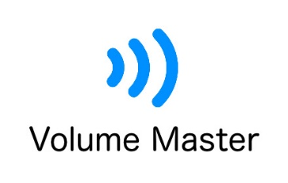


Disability Specific: Hearing
Volume, control and captions
  Ultimate Volume Booster
  Volume Master - increases volume
  Otter.ai - caption

Slide 26

Disability Specific: Seeing
Change in display, magnification, text-to-speech (TTS) basic screen reading
  Eye-Able Accessibility assistant - most comprehensive TTS tool, keyboard navigation on menus
  Zoom- similar to chrome zoom settings but more increments
  Beeline Reader – Faint horizontal line helps with finding cursor and reading

Slide 27
Jaws Accessibility
Theoretically accessible but practically inaccessible
  Extension shortcut keys incompatible
    Customization theoretically possible
  Extension access and privacy access inconsistent
  Many extensions use overlays – not accessible
  Nature of many extensions are inaccessible (i.e. annotation, font changes etc.

Slide 28

Disability Specific: Dyslexia
Changing font to make it easier to identify letters
  OpenDyslexic - works well for web reading, generally works well on Google pages
Notes:
There were many! We wanted to find out

Slide 29
Students Who Should Consider Extensions
Hesitant to use AT due to fear of stigma
Do not have AT funding or training
Need minimal support
Have some tech experience
Are not afraid to try and test options

Slide 30
Students Who May Not Want to Use Extensions
Already use a tool they find works well
Want to learn only one tool
Have complex or specialized needs
Need 1:1 training
Are anxious about using tech
Are using a screen reader or voice recognition

Slide 31
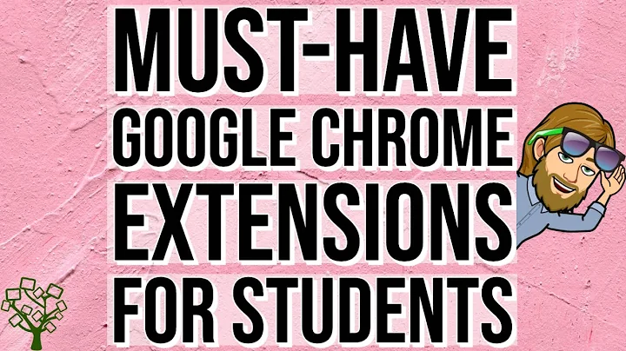
Demonstration and Resource
For more information please watch: Must-Have Google Chrome Extensions for Students

Slide 32

Thank You!
Adaptech Research Network: www.adaptech.org
Rosie Arcuri: rosie.arcuri@mail.mcgill.ca

