Slide 1

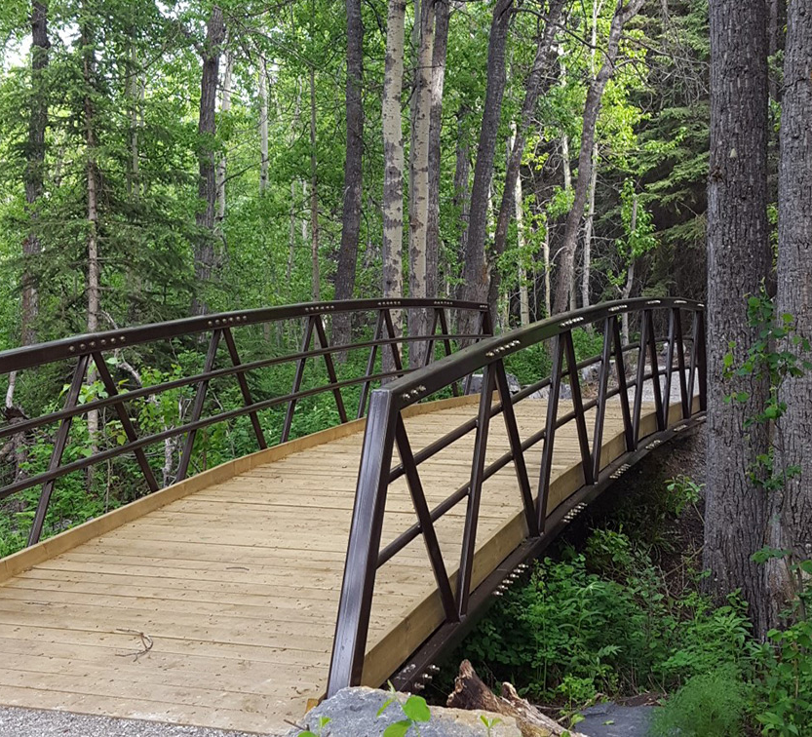
Is This Bridge Safe to Cross?
Fieldwork / Clinical Internship Experiences of Students with Disabilities
Alice Havel Susie Wileman
Adaptech Research Network
CACUSS Accessibility & Inclusion Summit
May 4, 2023

Slide 2
Agenda
Our research study
Campfire
Questions
Sharing feedback/comments

Slide 3
Who Are We?
Why Now?
Adaptech Research Network
Dawson College
ECQ
UD
Success stories vs. Pushback
Competencies

Slide 4

Goals of the Project
Explore facilitators and barriers
Include voices of three stakeholder groups
Create ‘deliverables’

Slide 5

Review of Literature
Mainly focused on
  Mental health concerns
  Psychology, Social Work, Law programs
  Frequently requested accommodations
Takeaways
  Importance of, and barriers to disclosure
  Need for mentorship
  Differences between visible & non-visible disabilities
  Lack of policy

Slide 6
Method
Advisory Board Meeting
    Faculty
    Dean
    Students with disabilities
    Accessibility Centre Advisor
    Pedagogical Counsellor
Individual Interviews x 3 groups
    Faculty fieldwork/clinical supervisors (n. 10)
    AccessAbility Centre advisors (n. 8)
    Students with disabilities (n. 14)
Thematic Analysis

Slide 7
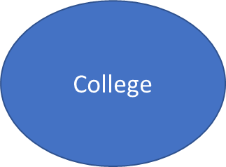
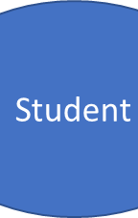
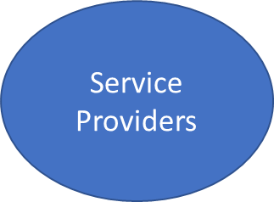
Questions We Asked
Facilitators
Barriers
Resources
  assistive technologies
  strategies
Role of the college
Recommendations

Slide 8
What Students Told Us
Need support for
  Communication
  Disclosure
  Assistive tech
  Mentorship / role models
  Visual representation of materials

Slide 9
What Faculty Told Us
Faculty Internship Supervisors need clarity
  Policy and protocol
  Confidentiality regulations
  Guidelines / best practices

Slide 10
What Accessibility Advisors Told Us
Need clarity
  Competencies being measured
  Fieldwork settings and appropriate accommodations
  College policy and protocol
  Best practices / models of success

Slide 11
Emerging themes
ROLE OF ACESSIBILITY SERVICES
Institutional Policy & Legislation
Communication
Knowledge

Slide 12

Over to you…

Slide 13
What items would you like to see in a toolkit aimed at facilitating the inclusion of students with disabilities in clinical internships?
Who should have these tools?

Slide 14
What do you see as the role of accessibility advisors in facilitating the inclusion of students with disabilities in internship settings?

Slide 15
How do you perceive the role of your institution in facilitating the inclusion of students with disabilities in clinical internships?

Slide 16
Do you have any ideas or suggestions as to how assistive technology can be used as a facilitator for students in internship settings?

Slide 17

Contact Information
Adaptech Research Network www.adaptech.org
Alice Havel ahavel@dawsoncollege.qc.ca
Susie Wileman swileman@dawsoncollege.qc.ca

Slide 18
Thank you!

