Slide 1












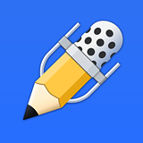





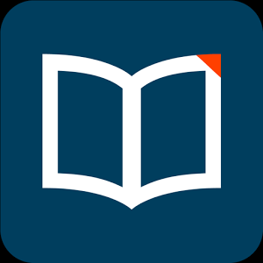
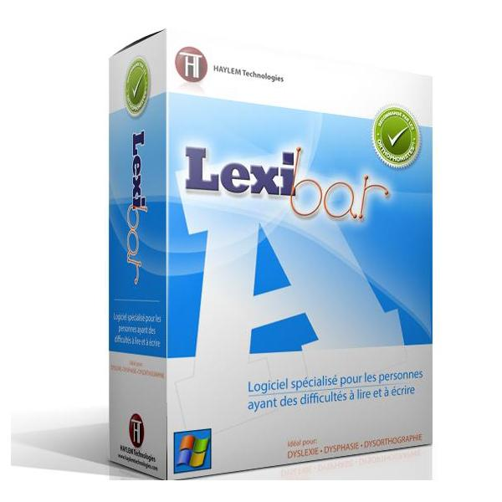
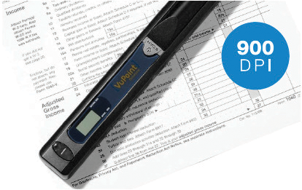



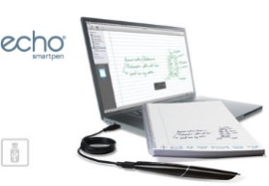
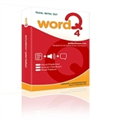




Title
When Free and Inexpensive Doesn’t Mean “Cheap”: Adaptech Research Network’s Free and/or Inexpensive Technology Database
Jillian Budd^{1,2,7}, Catherine Fichten^{1,2,4,5,7}, Evelyne Marcil^{1,2,4,7}, Christine Vo^{1,8}, Alex Lussier^{1,3,6}, Alice Havel^{1,4}, Laura King^{1,3}, Alexandre Chauvin^{1,8}, Cristina Vitouchanskaia¹, Mary Jorgensen¹, Jennison Asuncion¹
¹Adaptech Research Network ²McGill University ³Cégep André-Laurendeau ⁴Dawson College ⁵Jewish General Hospital ⁶Université de Montréal ⁷CRIR ⁸Concordia University
A compilation of free and inexpensive (FANDI) software, hardware, and mobile applications
Regularly updated
Bilingual
Adheres to the principle of Universal Design (accessible to individuals with various needs)
Remove the barriers that students faced in obtaining needed technologies
Share creative applications of inexpensive general-use technology with other students who might find them useful
Provide students with short-term solutions and the option of trying out different technologies
What is FANDI?
The Birth of FANDI
All database entries include:
  type and price
  developer and websites to find and download the product
  size and system requirements
  languages it works in
  the last time the entry was updated
  a detailed description of the program and its features
Database entries are organized alphabetically or by the type of technology an individual may need to accomplish a specific task:
  Adapted Keyboards
  Dictionary/Reference
  Organization/Productivity
  Alternative Mice
  Dictation
  Magnification
  Scanning and Optical Character Recognition (OCR)
  Screen Reading
  Writing
  Other
  Items
    Items
      Items
        Items
The Premise for FANDI
Database Components
Over the past 20 years, the Adaptech Research Network has highlighted the importance of information and communication technologies (ICTs) for students with disabilities.
Our research has found that most students with disabilities used some form of technology to facilitate their learning and these technologies had a positive impact on their success in postsecondary education
These students faced numerous obstacles accessing and using these technologies including:
  lack of knowledge of what was available
  where to buy the technologies
  whether a product would work well for them
  the prohibitive cost (over $1000 for software or hardware)
  inadequate opportunities to try various technologies before purchasing them
Built-in Accessibility Features
Many technologies have built-in features that can benefit anyone
In 2012, we reviewed the built-in accessibility features for Macintosh, Windows, and mobile Apple operating systems and added these to the database
By the end of June 2016, the database will include an updated list of built-in features for Windows, Macintosh, Android, and Apple devices including where to find these features and how to turn them on
Software/Hardware/Mobile Applications
The database includes:
  software and hardware for Windows and Macintosh computers
  mobile apps for Android and Apple devices
  mobile apps for Windows devices (end of June 2016)
All the entries in the database are either free or inexpensive ($200 CDN or less and less than $10 for mobile applications) and include free or limited trials
Each technology that is added to the database is tested by a team member to ensure that the program does what it is intended to do
38%
Some of Adaptech’s Favourites
ABBYY PDF Transformer
Dragon Naturally Speaking
Evernote
Inspiration
Lexibar
Livescribe Smartpen
Notability
OmniPage
TextAloud 3
Voice Dream Reader
VuPoint Magic Wand
WordQ
For more information and to access the database:
English: http://www.adaptech.org/downloads
French: http://www.adaptech.org/fr/telechargement

