Slide 1






There’s An App for That! All About Adaptech’s Free and/or Inexpensive Technology Database
Jillian Budd, Alice Havel
In Collaboration with
Catherine Fichten, Laura King, Christine Vo, Alexandre Chauvin, Alex Lussier, Evelyne Marcil, Cristina Vitouchanskaia & Jennison Asuncion
19th Annual Accessing Higher Ground, Westminster, Colorado
November, 2016

Slide 2
Agenda
Adaptech Research Network’s research findings
Overview of Free and/or Inexpensive Technology Database
Some favourites
Questions

Slide 3
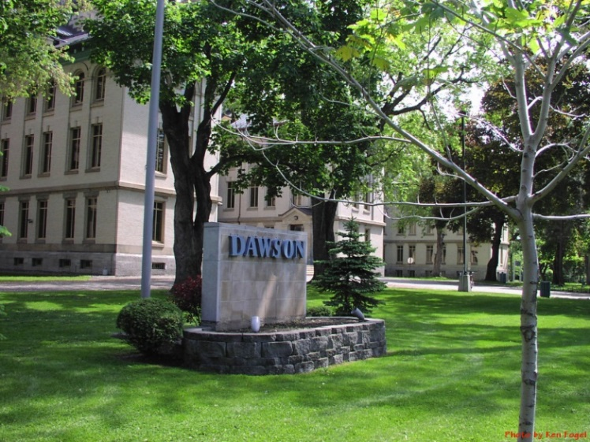
Presenters (1)
Jillian Budd
– Adaptech Research Network
– McGill University
jbudd@dawsoncollege.qc.ca
Notes:
Survey audience re their job/position. + Explain Cegep.

Slide 4
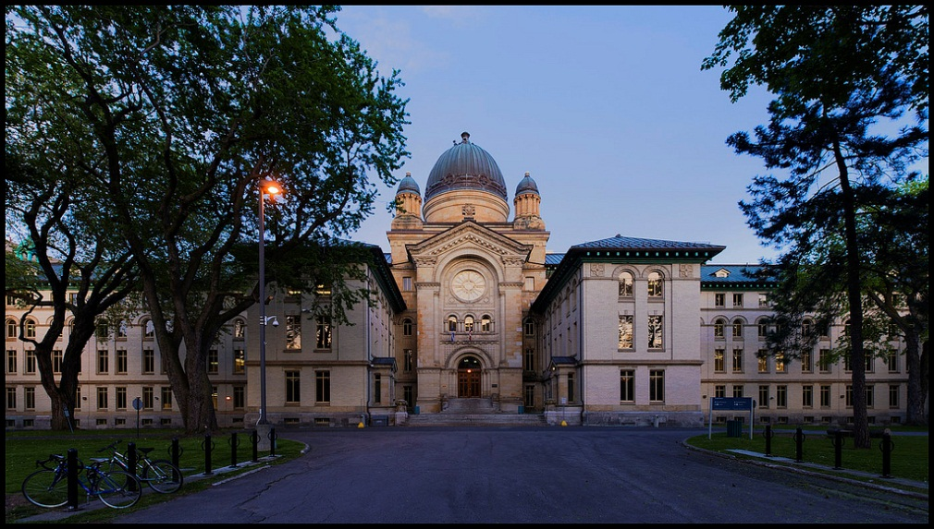
Presenters (2)
Alice Havel
– Adaptech Research Network
– Dawson College
ahavel@dawsoncollege.qc.ca
Notes:
Survey audience re their job/position. + Explain Cegep.

Slide 5
Adaptech Research Network
www.adaptech.org
Based at Dawson College since 1996
Funding: federal and provincial grants
Bilingual, empirical research
Team: faculty, students, professionals, consumers, community partners

Slide 6
Adaptech Research Focus
College / university students & graduates with disabilities
    Factors impacting student success
    Student outcomes after graduation
    Use and accessibility of information and communication technologies (ICTs)

Slide 7
Research Findings (1999-2001)
ICTs and students with disabilities in postsecondary education
    High cost of assistive technologies
    Poor compatibility
        Inadequate funding
Notes:
Canada-wide project
Inadequate funding for both on and off campus
Cross use technoligies:(i.e., technologies intended for students with one type of disability used by students with a different disability)
General use – students were using general use products as assistive aids like a casio tape recorder (e.g., tape recorder)
Professors noted that pedagogical practices useful for students with disabilities are good pedagogical practices in general

Slide 8
Research Findings (1999-2001)
    Students shared low-cost alternatives
General-use ICTs used as assistive aids
"Cross-use” technologies
        “Quick and dirty" solutions for faculty
Notes:
Canada-wide project

Slide 9
Research Findings (2009)
Development and validation of the POSITIVES Scale
    ICT needs better met on campus than at home
    Concern regarding funding of ICTs for personal use
    Lack of institutional ICT loan programs
Notes:
Canada-wide project
Postsecondary Information Technology Initiative Scale

Slide 10
Research Findings (2012)
ICTs and students with learning disabilities
    ICTs recommended by experts not used by students
    Students used general-use ICTs (e.g., Smartphone, MP3)
Notes:
Quebec-based project

Slide 11
Specialized ICTs Used by Students with LD and Experts’ Recommendations
Specialized ICTs | Students with LD | Experts
Kurzweil 3000 | 6% | 45%
Wynn | 3% | 19%
Dictation software | 10% | 65%
WordQ | 25% | 29%
Text-to-speech software | 18% | 38%
Scanning/OCR | 27% | 9%
Mind-mapping/concept mapping | 10% | 41%
Smartpen | 3% | 3%
Notes:
Check how items were asked

Slide 12
General-Use ICTs Used by Students with LD and Experts’ Recommendations
General-Use ICTs | Students with LD | Experts
Office suite | 86% | 71%
Antidote | 65% | 47%
Electronic dictionary | 58% | 2%
MP3 to listen to books/texts | 30% | 2%
E-book | 11% | 0%
PDF | 74% | 0%
Digital recorder | 16% | 16%
Laptop | 85% | 36%
Smartphone/iPod etc. | 69% | 10%

Slide 13
Research Findings (2016)
Student and faculty perspectives on excellence in ICT use in college
    Students like to use their own ICTs in class
        Laptops
        Tablets
        Smartphones
Notes:
Quebec-based project that began in 2014 and is ongoing

Slide 14
From Research to Real Life
Barriers students faced
  Prohibitive cost (>$1000) of adaptive technologies
  Lack of knowledge of available products
  Inadequate opportunities to try products before purchasing
  Lack of information about where to purchase products
Notes:
Not knowing if a product would work well for them
Make sure to explain that these are for assistive/adaptive technologies

Slide 15
Adaptech’s Response
Remove ICT related barriers
Provide students with:
    Information on existing low cost ICTs
    Creative applications of inexpensive, general-use technology
    Short-term solutions
    “Quick and dirty” solutions

Slide 16
Precursor to FANDI
As a first response to the early research findings, Adaptech:
  Compiled a resource booklet
  Moderated an e-mail discussion forum
  Put a listing of ICTs used by students on our website
Notes:
concrete results:
1999: 1) Compiled resource booklet
2) Instruments and listing of specific hardware and software used by students put on website
http://omega.dawsoncollege.qc.ca/adaptech/olt99app.pdf
3) Adaptech Discussion Forum - A moderated e-mail discussion forum. Keeps project members and other interested individuals informed and involved with our research. Facilitates useful dialogue on issues and themes as they relate to our interest areas. For more information or to subscribe, send an e-mail message to our Moderator, Jennison Asuncion, at <j_asunc@alcor.concordia.ca>.

Slide 17

The Birth of FANDI
Free and Inexpensive Technology Database (FANDI)
    Evolved from listing of ICTs
Notes:
Explain where the listing came from (i.e., suggestions/answers from students, experts/service providers, vendors)

Slide 18
FANDI’s Evolution
Bilingual database
Product listings for different platforms
Demonstration videos
Descriptions / instructions for built-in accessibility features

Slide 19
FANDI in 2016
Built-in Features
Products
Windows 7, 8.1, & 10
Software & Hardware
Mobile Applications
Mac OSX
Windows
Windows 10
Apple iOS for iPhone, iPad, & iPod
Apple
Macintosh
Android
Android devices

Slide 20
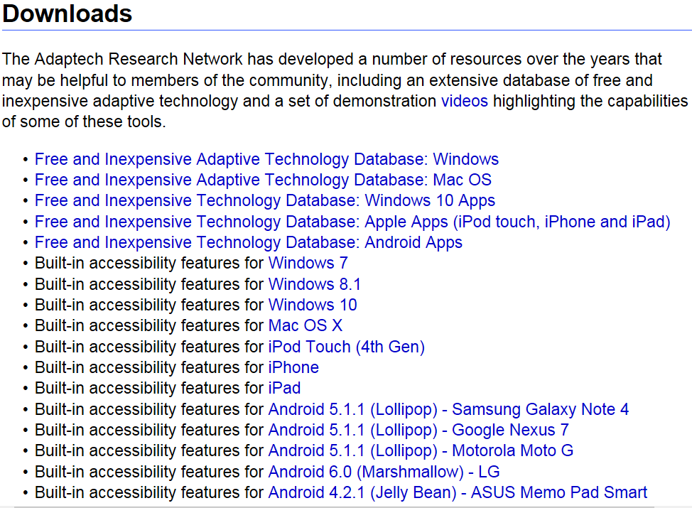

Slide 21
Product Guidelines
Software/Hardware - Windows & Macintosh
Applications - Apple, Android & Windows 10
Lite versions
Free trials
≤ $200
≤ $10
Free trials
Limited trials

Slide 22





Product Categories (1)
    Adapted Keyboards
    Dictionary/Reference
    Organization/Productivity
    Alternative Mice
    Dictation

Slide 23





Product Categories (2)
    Magnification
    Scanning & Optical Character Recognition (OCR)
    Screen Reading
    Writing
    Other (including multipurpose programs)

Slide 24
Product Entries Include (1)
Developer name
Type (free, free trial, limited trial, payware)
Price
Websites to find and download the product
Languages the product works in

Slide 25
Product Entries Include (2)
System requirements
Detailed description of the product’s features written by a team member
Last time the entry was updated by a team member

Slide 26


Finding a Product on the Database
Database entries are organized:
    Alphabetically
    By function rather than disability
Notes:
Database entries are organized alphabetically or by the type of technology an individual may need to accomplish a specific task

Slide 27
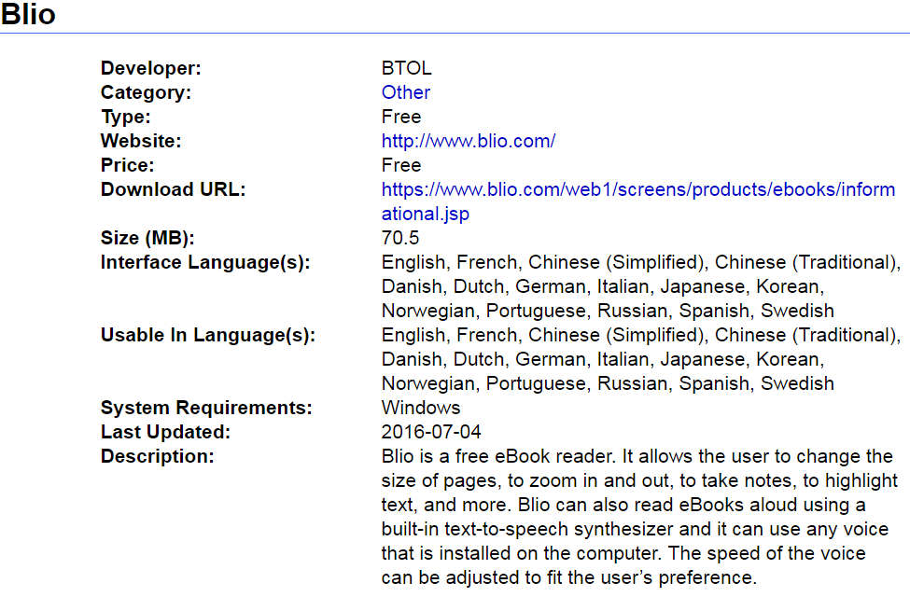
Example of a Product Entry
Notes:
Description: Features of the program based on testing
Specific information regarding features of the product
Short, clear, concise, and neutral language

Slide 28
Finding New Technologies
Suggestions from users
Conference presentations
Word of mouth
Vendor / developer advertisement
Websites
Online “stores”

Slide 29
Selection / Testing Process
Does it fit our criteria regarding cost?
Does it have a trial?
Can it benefit post-secondary students?
Do the features work?
How easy / difficult is it to use?
Notes:
Make note of secondary but not primary/remedial products

Slide 30

Keeping FANDI Afloat
Summer students
Volunteers
Funding
Inflation
Bilingual

Slide 31
Some Of Our Well-known Favorites
Notability
SmartPen
Inspiration
Cmap
ABBYY Transformer+
WordQ
TextAloud
Evernote

Slide 32
Some of Our Lesser Known Favorites
Foxit PhantomPDF
OneNote
Balabolka
Blio
Cool Reader
DrawExpress
Typ-O

Slide 33
Your Favorites
What are some of your favorite free and/or inexpensive technologies?

Slide 34

Questions?

Slide 35
Contact Us
Adaptech Research Network
  www.adaptech.org
  www.adaptech.org/downloads
Jillian Budd
  jbudd@dawsoncollege.qc.ca
Alice Havel
  ahavel@dawsoncollege.qc.ca

